Slide 1

Synchronization patterns in coupled optoelectronic oscillators
Caitlin R. S. Williams
University of Maryland
Dissertation Defense
Tuesday 13 August 2013

Slide 2
My Research
Random Number Generation:
  C. R. S. Williams, J. C. Salevan, X. Li, R. Roy, and T. E. Murphy. “Fast physical random number generator using amplified spontaneous emission.” Optics Express, 18(23):23584-23597 (2010).
Optoelectronic Oscillators and Synchronization:
  T. E. Murphy, A. B. Cohen, B. Ravoori, K. R. B. Schmitt, A. V. Setty, F. Sorrentino, C. R. S. Williams, E. Ott, and R. Roy. “Complex dynamics and synchronization of delayed-feedback nonlinear oscillators.” Phil. Trans. R. Soc. A, 368(1911):343-366 (2010).
  C. R. S. Williams, T. E. Murphy, R. Roy, F. Sorrentino, T. Dahms, and E. Schöll, “Group Synchrony in an Experimental System of Delay-coupled Optoelectronic Oscillators,” Conference Proceedings of NOLTA2012, 70-73 (2012).
  C. R. S. Williams, T. E. Murphy, R. Roy, F. Sorrentino, T. Dahms, and E. Schöll. “Experimental observations of group synchrony in a system of chaotic optoelectronic oscillators.” Phys. Rev. Lett., 110:064104 (2013).
  C. R. S. Williams, F. Sorrentino, T. E. Murphy, and R. Roy. “Synchronization States and Multistability in a Ring of Periodic Oscillators: Experimentally Variable Coupling Delays.” Manuscript submitted.

Slide 3
Outline
Introduction: Dynamical Systems and Synchronization
Synchrony of periodic oscillators in a unidirectional ring
Group synchrony of chaotic oscillators

Slide 4
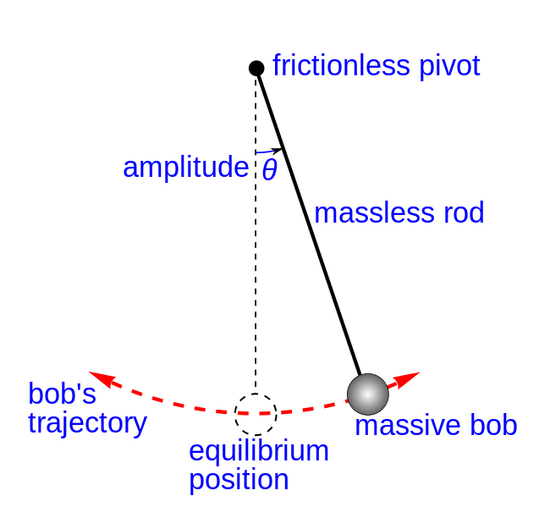
Pendulum: The Simplest Dynamical System
For an ideal, small amplitude oscillation:
Not so simple for large amplitudes or real pendulum!
Notes:
Can be chaotic or not
Systems have nonlinearities that make it difficult to analyze, only recently do we understand these
Motivation for studying our experiment
Pendulum – simple, but gets complicated at large amplitudes
Wikipedia.org

Slide 5

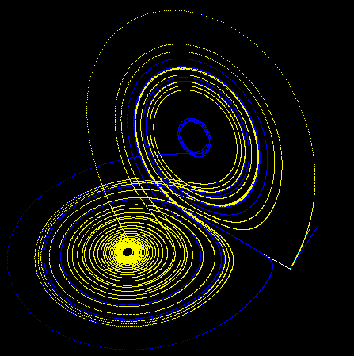
Weather: Example of Chaos
Lorenz System:
Deterministic
Sensitive to initial conditions
Image: Wikipedia.org
Notes:
– sensitive to initial conditions/predictability
Weather huge complexity, impossible to simulate and analyzing
Pictures from Wikipedia

Slide 6
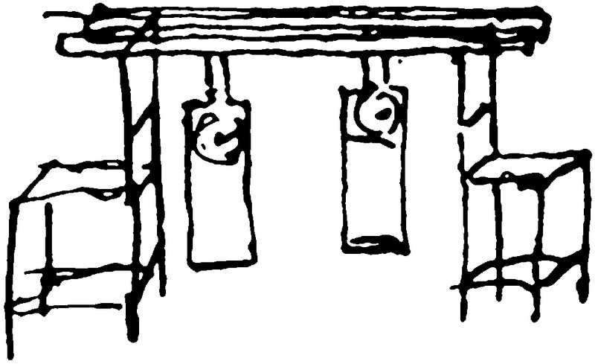

Synchronization of Periodic Oscillators
Metronome Synchronization (IkeguchiLab on YouTube)
Notes:
http://www.youtube.com/watch?v=JWToUATLGzs&feature=youtu.be
Time keeping/GPS – Receiver calculates time delay of message transit from satellites, and uses the satellite positions to calculate position on the ground – satellite clocks must be synchronized
Chaotic and periodic systems can synchronize – well-known, and necessary in many applications
Wikipedia.org

Slide 7
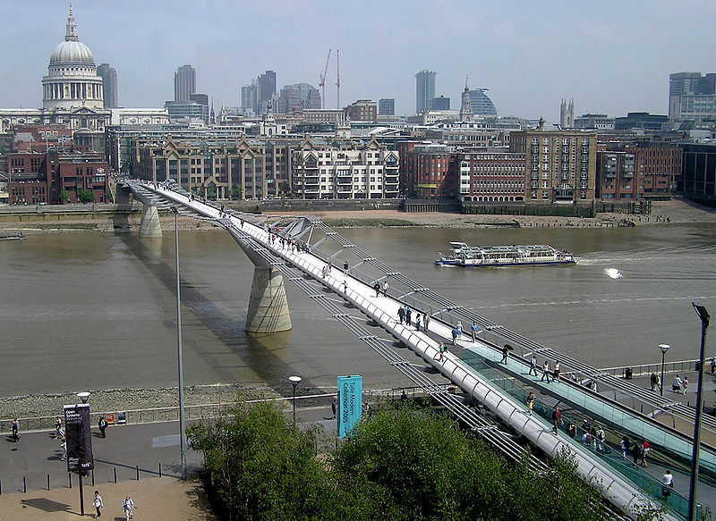
Synchronization Example: Millennium Bridge
Bridge-pedestrian coupling created pedestrian synchrony and bridge swaying!
Notes:
Millenium bridge - not necessarily periodic, but swaying/coupling of bridge brings them into synchrony
S. H. Strogatz, D. M. Abrams, A. McRobie, B. Eckhardt & E. Ott. “Theoretical mechanics: Crowd synchrony on the Millennium Bridge,” Nature 438, 43-44 (2005).

Slide 8
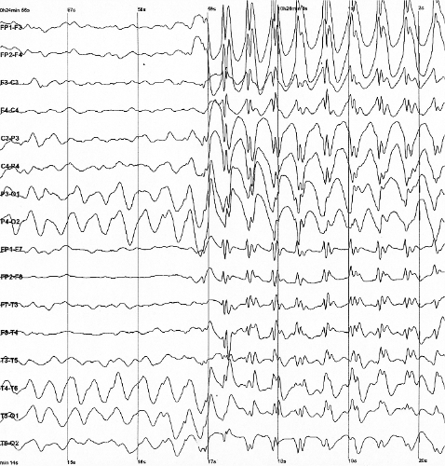
Synchronization of Brain Signals
Image: Wikipedia.org
Notes:
Chaos sychrony surpisng
EEGs from epileptic seizures – recording of electrical signals in the brain
Wikipedia.org

Slide 9
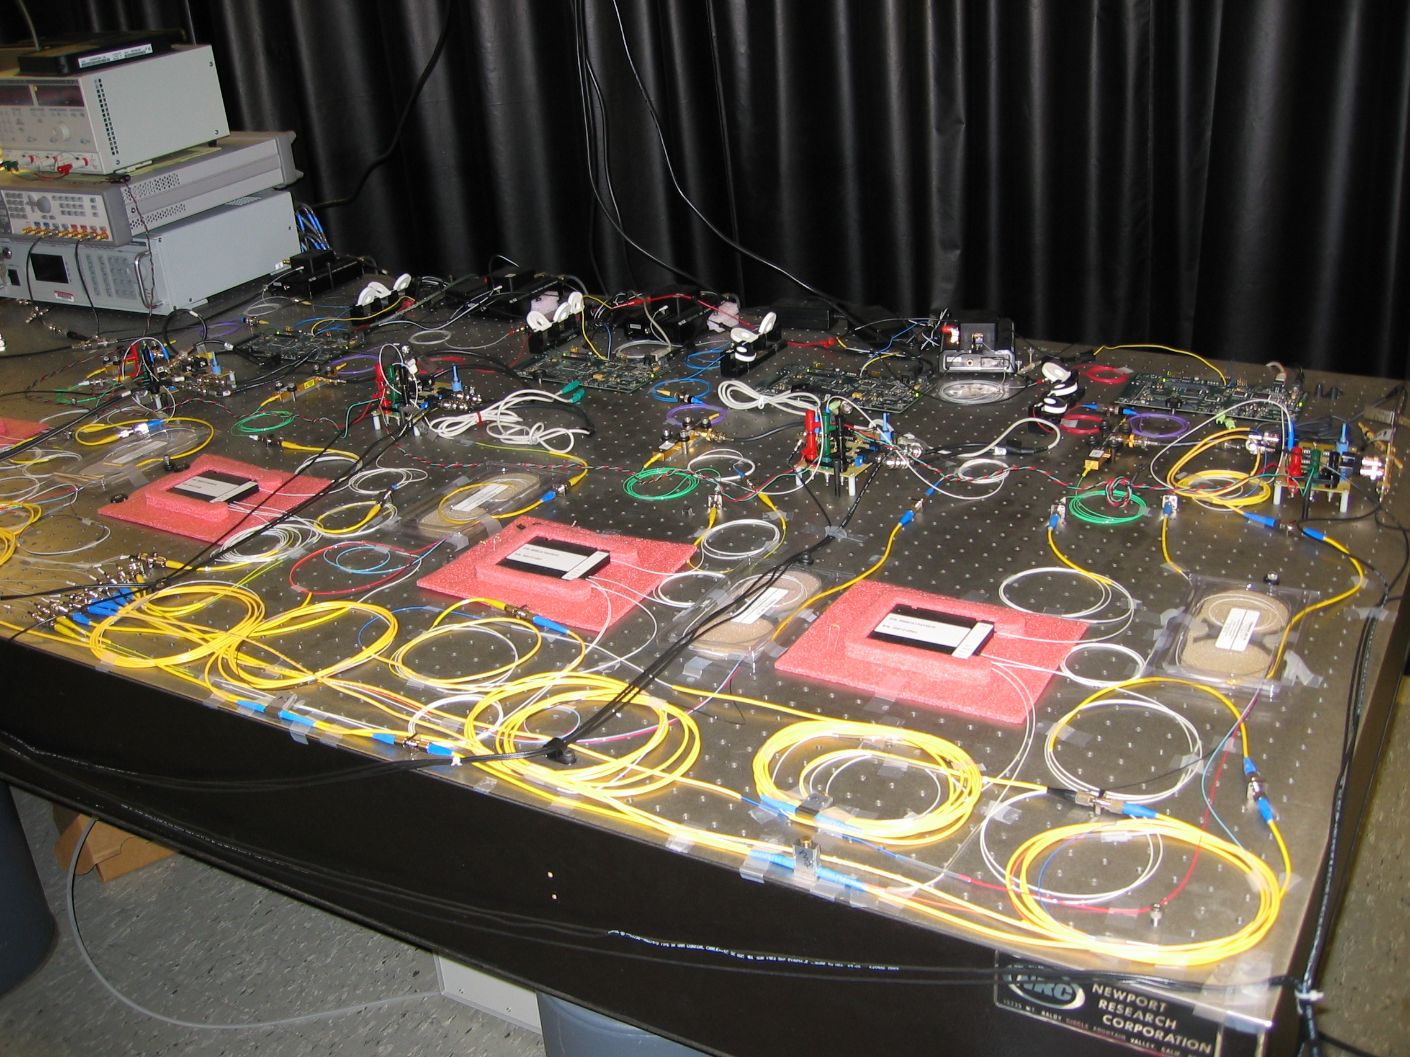
Experiment

Slide 10
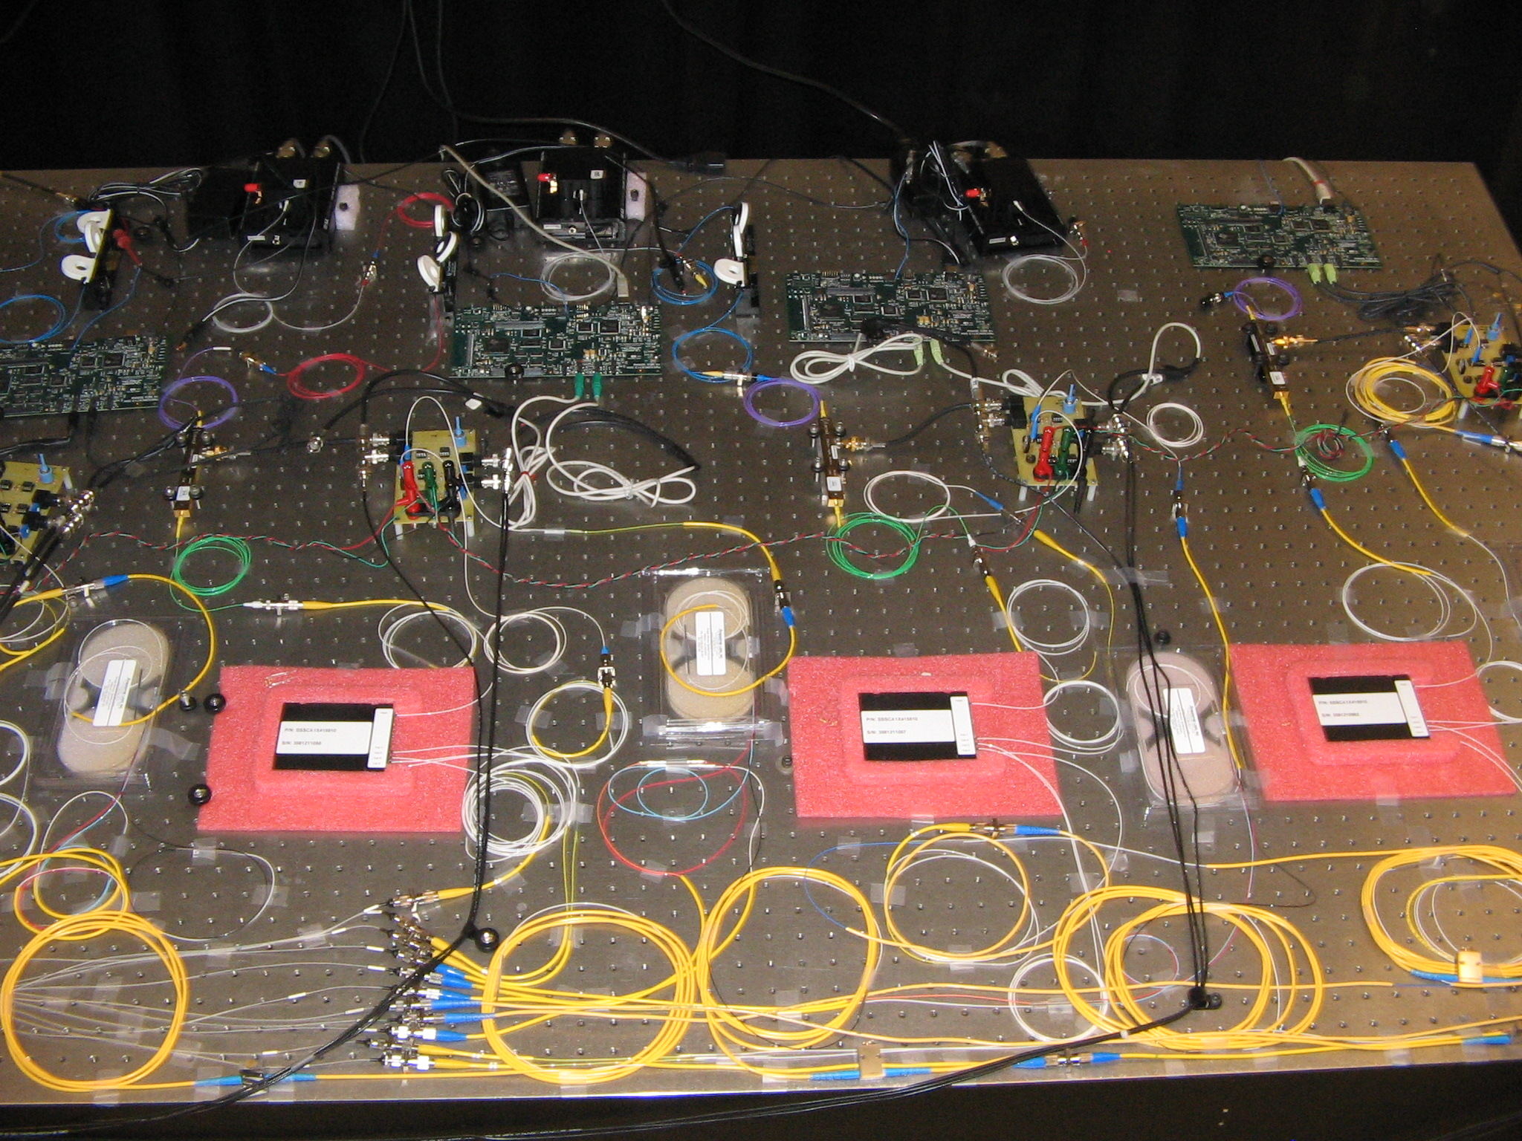
Experiment
Laser
Digital Signal Processing
(DSP) Board
Insert photo of experiment here
Mach-Zehnder
Modulator
Photoreceivers and
Voltage Amplifier

Slide 11
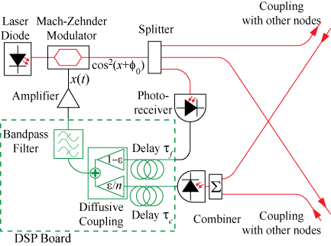
Experimental Diagram
Notes:
-Note that coupling can be adjusted – links removed, weights changed
-references to A and B’s work
Mention mode of coupling
Include plot of nonlinearity
-Point out colors of connections

Slide 12
Nonlinearity
P
V
Transmission:
V

Slide 13
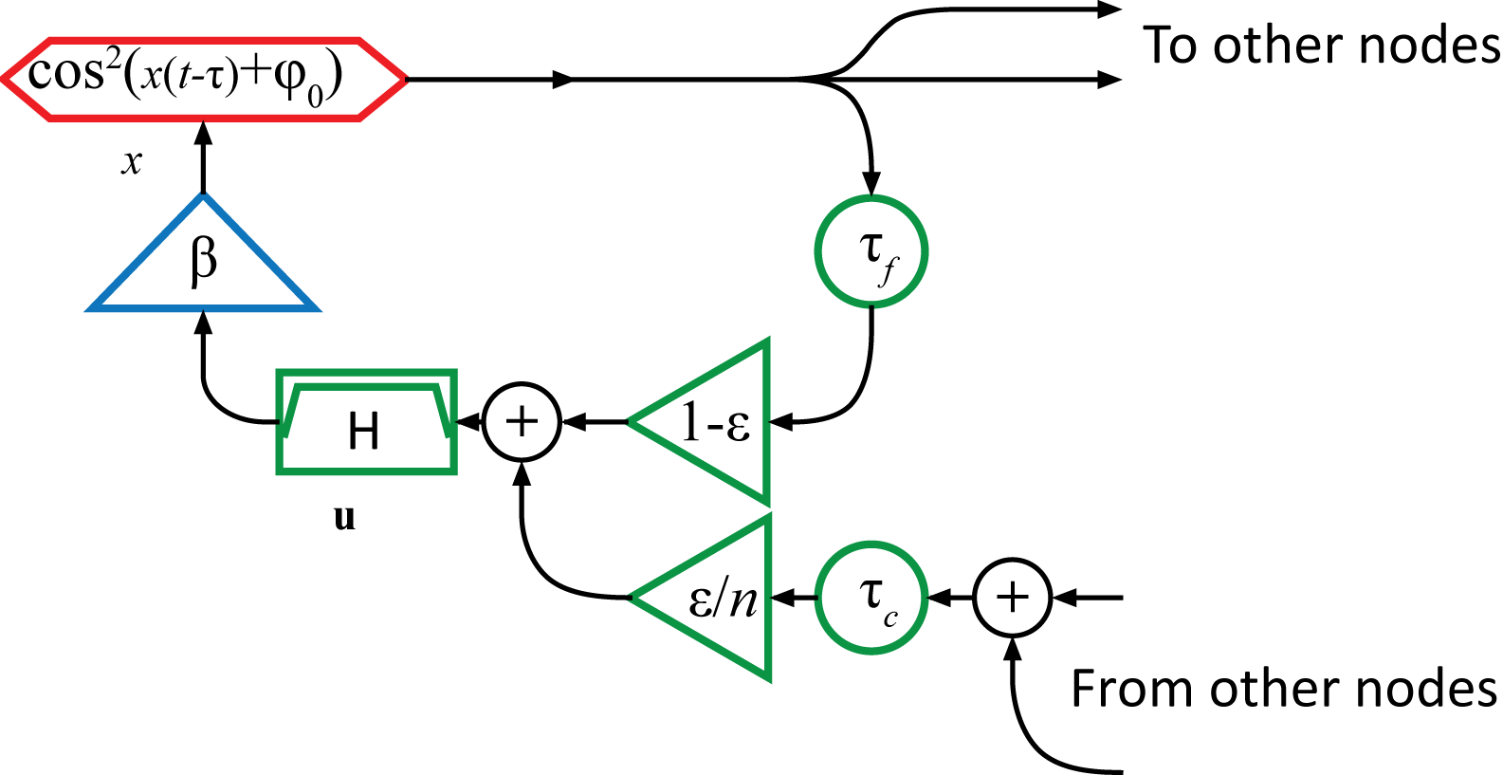
Single Node Block Diagram
Notes:
-also here, change tauc and tauf, also ‘To Other Nodes’ and ‘From Other Nodes
-epsilon/2->epsilon/n
-time-delayed feeback, nonlinear
-paradigm to neuronal systems – reasons for this type of system
-coupling parameters
-feedback strength

Slide 14
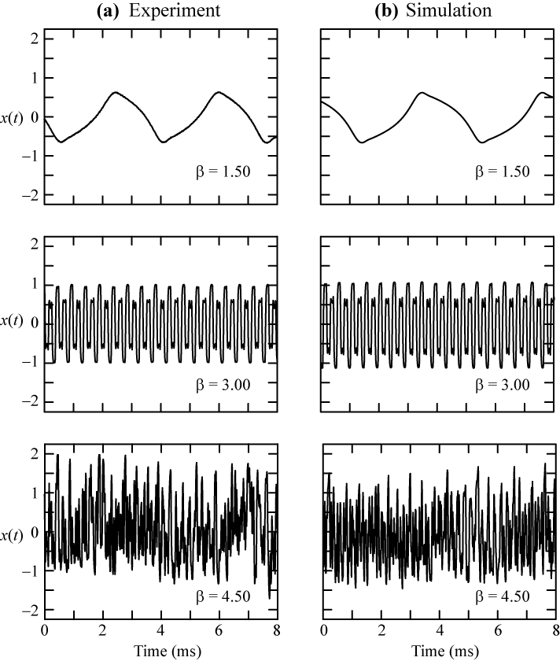
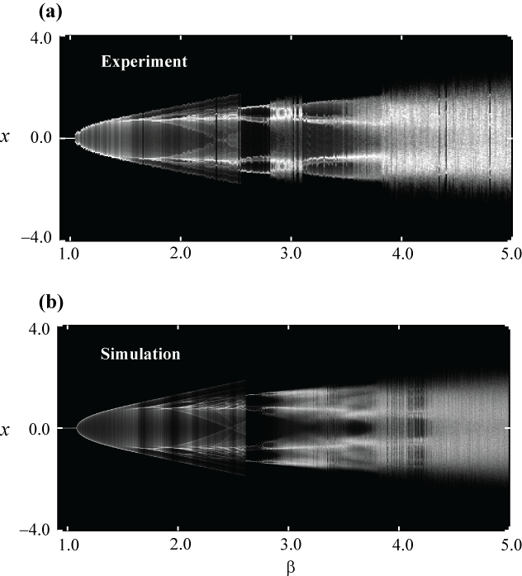
Dynamics of a Single Node
β
Notes:
SYNCHRONIZATION OF CHAOTIC
OPTOELECTRONIC OSCILLATORS:
ADAPTIVE TECHNIQUES AND THE
DESIGN OF OPTIMAL NETWORKS
-add beta x axis
-what is x?

Slide 15
Dynamics of a Single Node
Notes:
-variety of dynamics
-transitions are
-give intuition about instability, oscillation frequency
-show time traces of neuronal dynamics and variety, for motivation
-siezure eegs – periodic (normal activity mildly chaotic)
-dynamics can be seen on 3 and 4 neurons

Slide 16
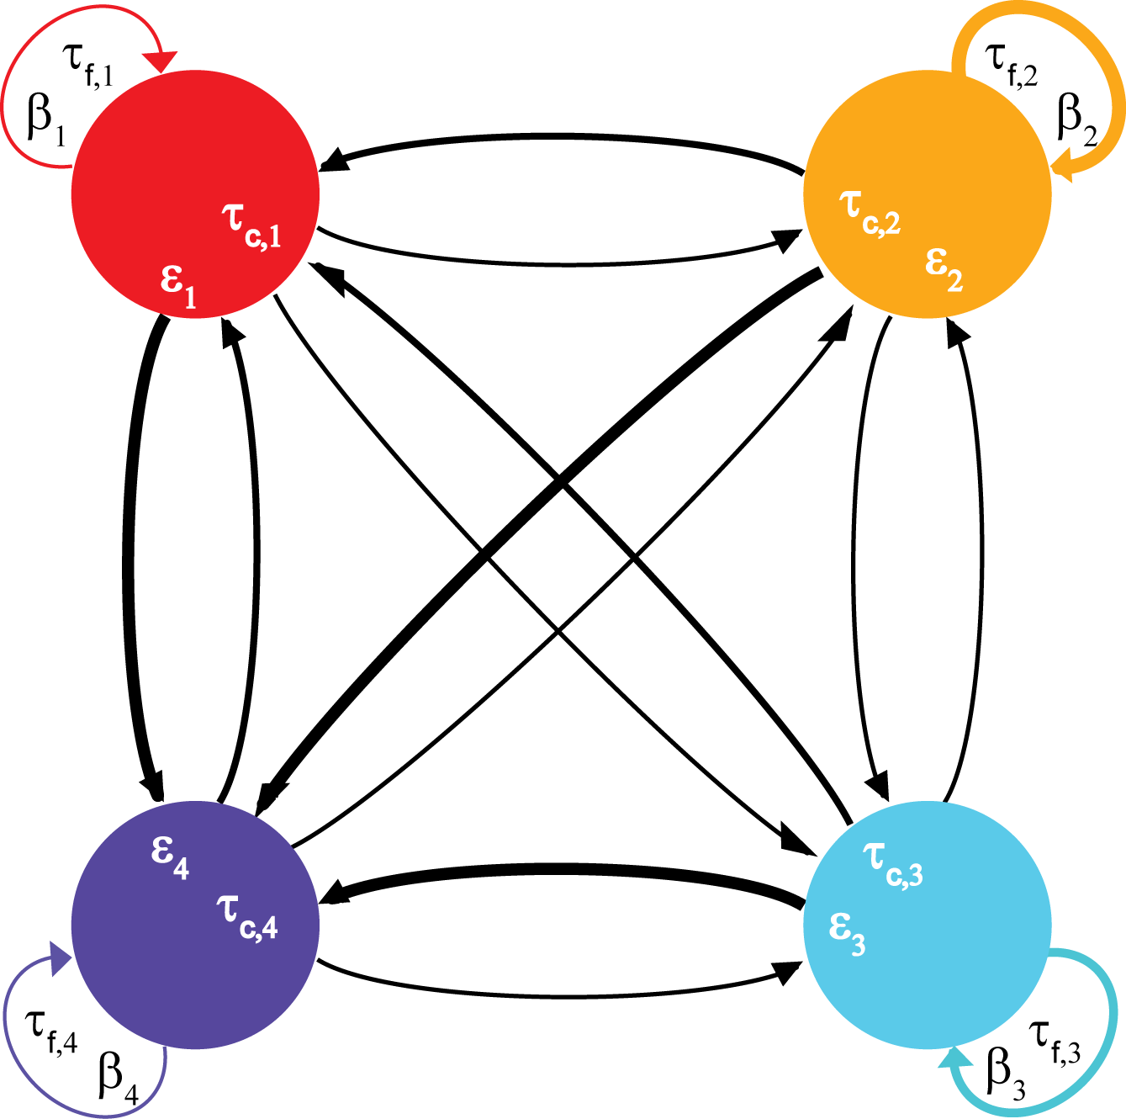
Four Node Network: Flexible Experiment

Slide 17
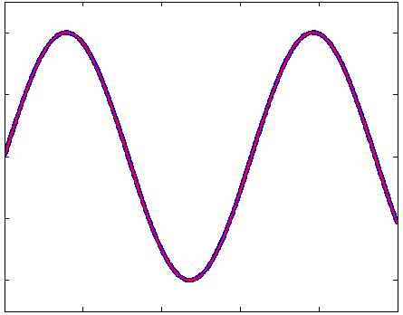
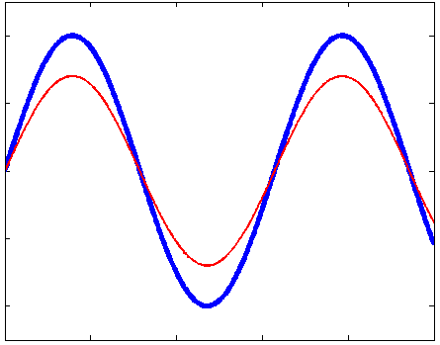
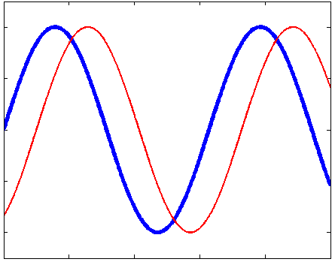
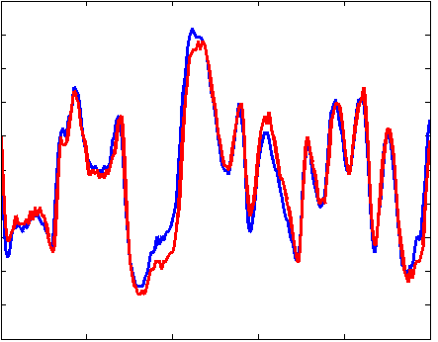
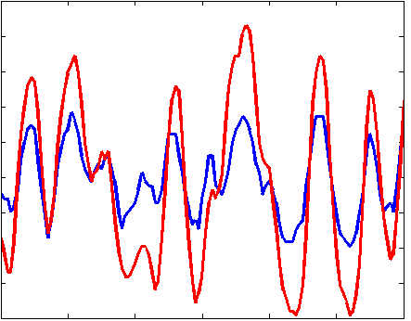
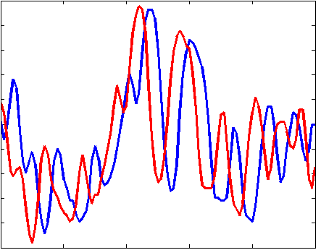
Synchronization Types
Identical, isochronal
Phase
Lag (amplitude)
Notes:
-Some examples of synchronization between two dynamical systems
-Lag synchronization can be combined with either phase synchronization or amplitude synchronization
-add corresponding periodic cases
-two experimental systems not completely identical
-say more about phase/phase sync for chaotic

Slide 18
Phase Synchrony States
Control of phase synchronization states in coupled oscillators is interesting because of neurological disorders and other phenomena observed in coupled neurons
Interested in controlling synchronization in coupled oscillators from complete synchrony, cluster synchrony, and different types of lag synchrony, specifically ‘splay phase’ synchrony
Notes:
-still nonlinearity, so difficult to analyze
-to control synchronization, what parameters can we change?

Slide 19
Coupled Periodic Oscillators

Slide 20
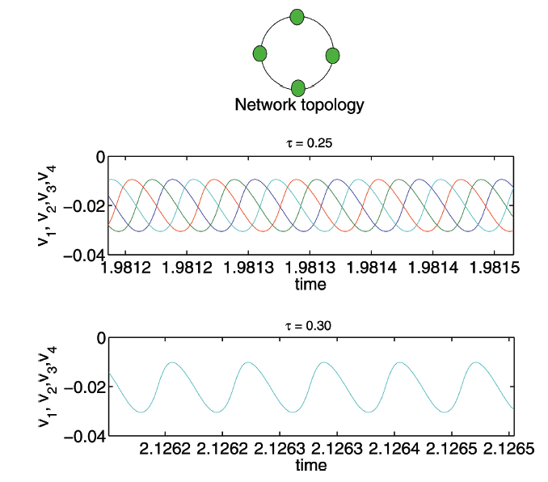
Unidirectional Ring of Neurons
Coupled Neurons: Transitions from lag to isochronal synchrony
v is membrane potential
h, m are membrane channel gating variables
Notes:
-In most experiments, it is difficult to change the time delays, but neurons always have coupling delays
-Leech-Heart interneuron model
-use term splay phase

Slide 21
Background
In numerical and analytical studies, changing the coupling delay has produced different synchronization states

Slide 22
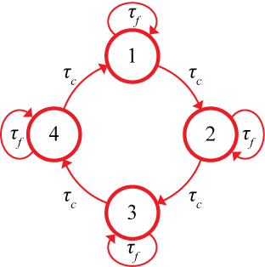
Experiment on Unidirectional Ring
Notes:
-We have a system where the coupling delay is easily varied experimentally

Slide 23
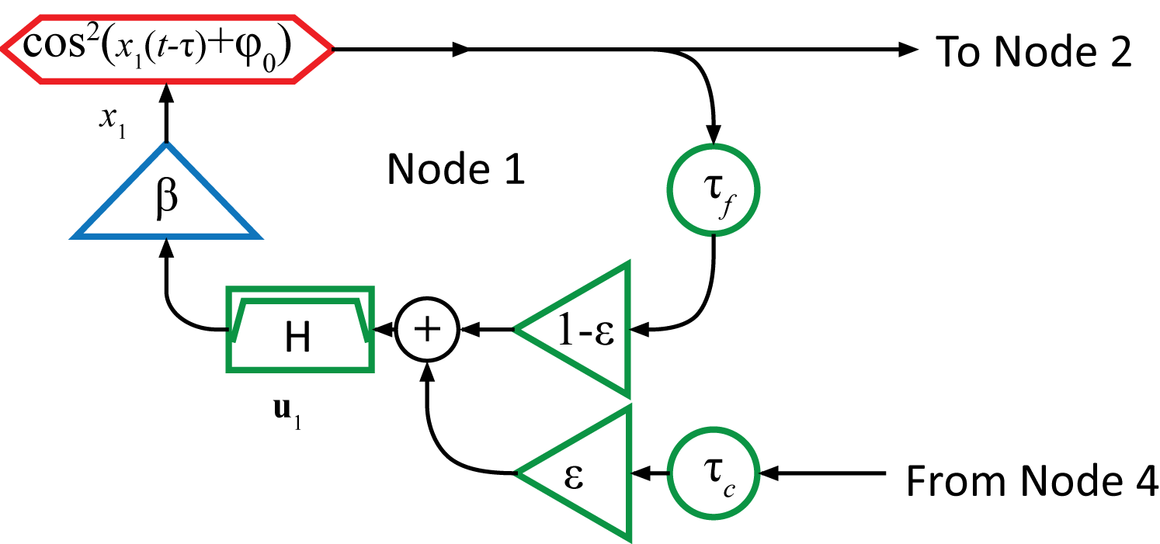
Mathematical Model
Notes:
-Note here that both coupling delay and feedback delay are the same
-E,F,G filtering (on next slide)
-explain DC bias
-change all parameters- specify
-point out coupling matrix for unidirectonal ring

Slide 24
Mathematical Model
Notes:
-1.2 periodic dynamics

Slide 25
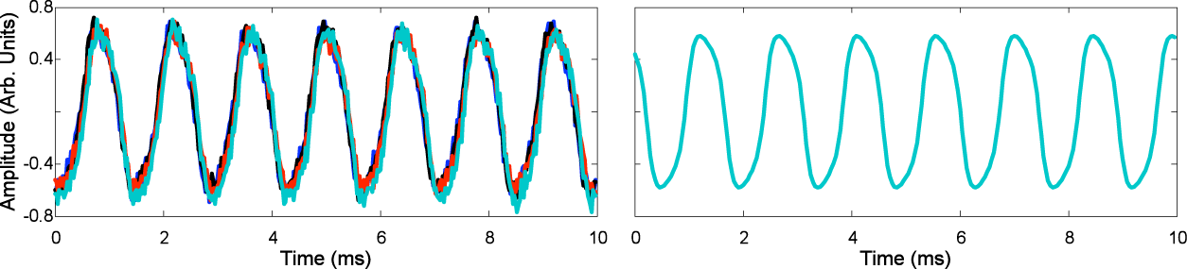
Tuning Coupling Delay
Experiment
Simulation
Isochronal Synchrony
(Phase = 0)
Notes:
-The coupling delay is varied, keeping the other parameters the same, and keeping each of the coupling delays identical to one another
-Isochronal syncrhony
-As I increase the coupling delay, four distinct synchronization behaviors occur
-in-phase versus out-of-phase: delay synchrony
-For the delay values shown on this slide, the corresponding behavior is the only stable behavior, so for any initial conditions, this is the behavior that the system settles into
-For some values of delay that fall between the values shown here, there may be a bistability between two of the four behaviors, meaning that for some initial conditions, the result is one behavior, but for other initial conditions, the result is another behavior
-These are the only four behaviors present for any coupling delay

Slide 26
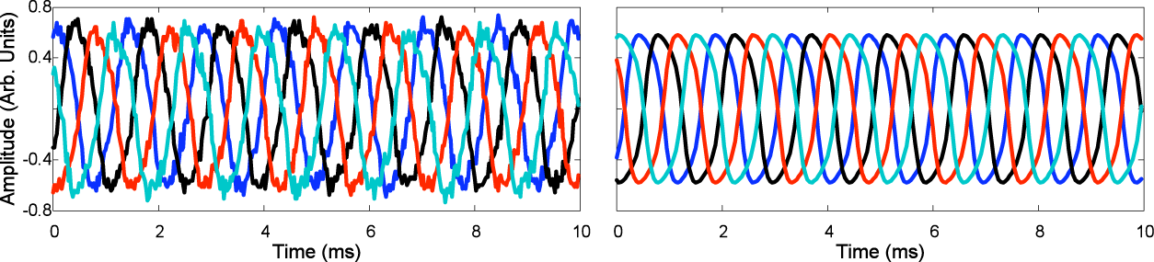
Tuning Coupling Delay
Experiment
Simulation
Splay-phase (Lag) Synchrony
(Phase = π/2)
Notes:
-The coupling delay is varied, keeping the other parameters the same, and keeping each of the coupling delays identical to one another
-Isochronal syncrhony
-As I increase the coupling delay, four distinct synchronization behaviors occur
-in-phase versus out-of-phase: delay synchrony
-For the delay values shown on this slide, the corresponding behavior is the only stable behavior, so for any initial conditions, this is the behavior that the system settles into
-For some values of delay that fall between the values shown here, there may be a bistability between two of the four behaviors, meaning that for some initial conditions, the result is one behavior, but for other initial conditions, the result is another behavior
-These are the only four behaviors present for any coupling delay

Slide 27
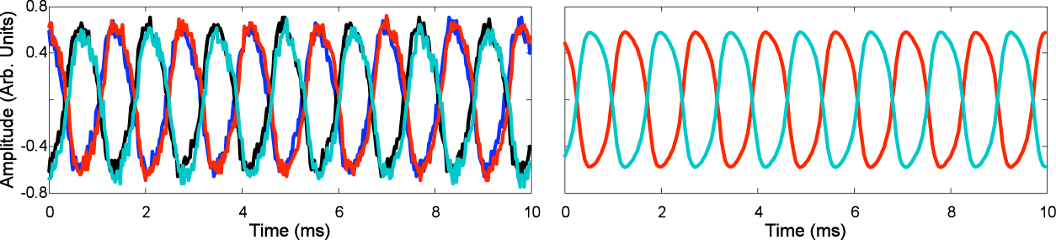
Tuning Coupling Delay
Experiment
Simulation
Cluster (Lag) Synchrony
(Phase = π)
Notes:
-The coupling delay is varied, keeping the other parameters the same, and keeping each of the coupling delays identical to one another
-Isochronal syncrhony
-As I increase the coupling delay, four distinct synchronization behaviors occur
-in-phase versus out-of-phase: delay synchrony
-For the delay values shown on this slide, the corresponding behavior is the only stable behavior, so for any initial conditions, this is the behavior that the system settles into
-For some values of delay that fall between the values shown here, there may be a bistability between two of the four behaviors, meaning that for some initial conditions, the result is one behavior, but for other initial conditions, the result is another behavior
-These are the only four behaviors present for any coupling delay

Slide 28
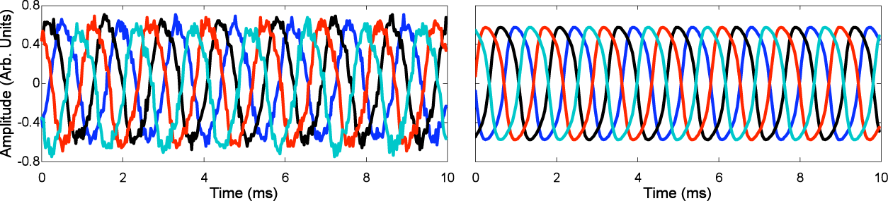
Tuning Coupling Delay
Experiment
Simulation
Splay-phase (Lag)
Synchrony
(Phase = 3 π/2)
Notes:
-The coupling delay is varied, keeping the other parameters the same, and keeping each of the coupling delays identical to one another
-Isochronal syncrhony
-As I increase the coupling delay, four distinct synchronization behaviors occur
-in-phase versus out-of-phase: delay synchrony
-For the delay values shown on this slide, the corresponding behavior is the only stable behavior, so for any initial conditions, this is the behavior that the system settles into
-For some values of delay that fall between the values shown here, there may be a bistability between two of the four behaviors, meaning that for some initial conditions, the result is one behavior, but for other initial conditions, the result is another behavior
-These are the only four behaviors present for any coupling delay

Slide 29
Varying Coupling Delay
Experiment
10 Measurements per delay
Simulation
2000 Random initial conditions per delay
Frequency of Occurrence (%)
Notes:
-This illustrates the frequency of occurrence of each of the four behaviors as time delay is increased
-We’d like to further increase the time delay to see if this trend continues, or if there is some different behaviors for long time delays

Slide 30
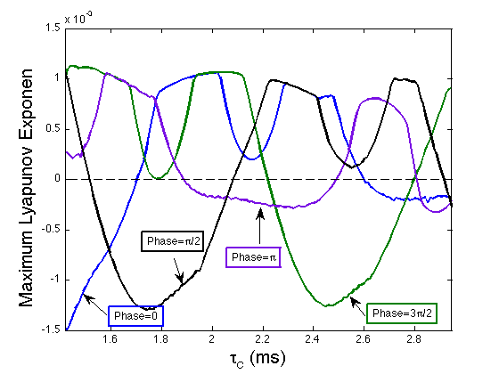
Predicted Stability
Notes:
Briefly discuss stability calculations
Show comparison of MSF with experiment (one transition?)
-’coupling delay’ on x axis
-change of stability of different patterns

Slide 31
Coupled Chaotic Oscillators

Slide 32
Group Synchrony
Groups of different oscillators
Intra-group identical synchrony, but not inter-group
This has been studied numerically and analytically, but previously not in an experiment
Notes:
-So we know some of the synchronization types for two systems, let’s talk about the synchronization that can occur for multiple coupled systems
-Our experiments focus on cases with no intragroup coupling, but the theory can include other cases
-Sorrentino and Ott developed a Master Stability Function (MSF) analysis for group sync
Dahms, et al. extended the analysis
Mention chaotic dynamics

Slide 33
Cluster Synchrony
Special case of group synchrony with identical nodes

Slide 34
Motivation
Neurons can display a variety of dynamical behaviors, and they are coupled to each other
Notes:
-two possible groups of neurons
-uni-hemispheric sleep as far-fetched examples (pic from wikipedia)
-where is this observed - seals
-marine and avian animals
-each half of the brain is doing something different, coupling between various neurons
-Asymmetrical Slow-wave Sleep
-Here, right shows higher synchronization in slow wave activity

Slide 35
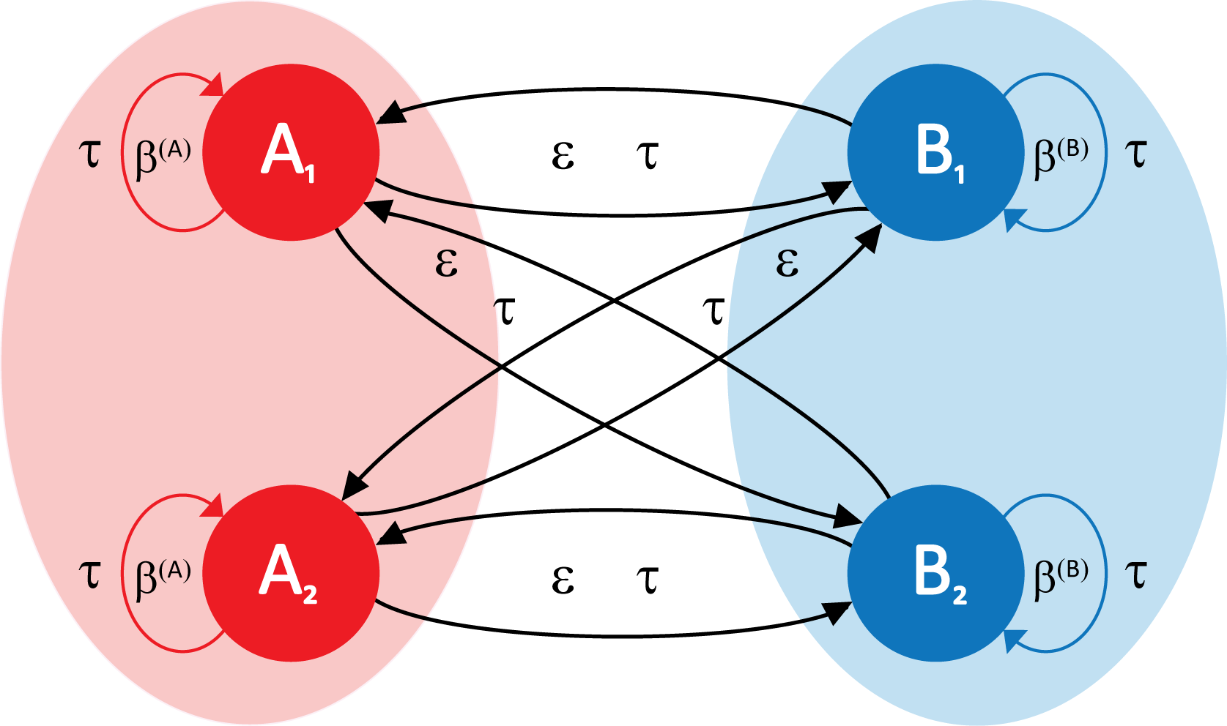
Experimental Network Structure
Notes:
-As you can see, there are no coupling links between nodes of the same group
-remarkable that no direct coupling between nodes in the same group, but identical synchrony, though only coupled through mediating nodes of other group

Slide 36
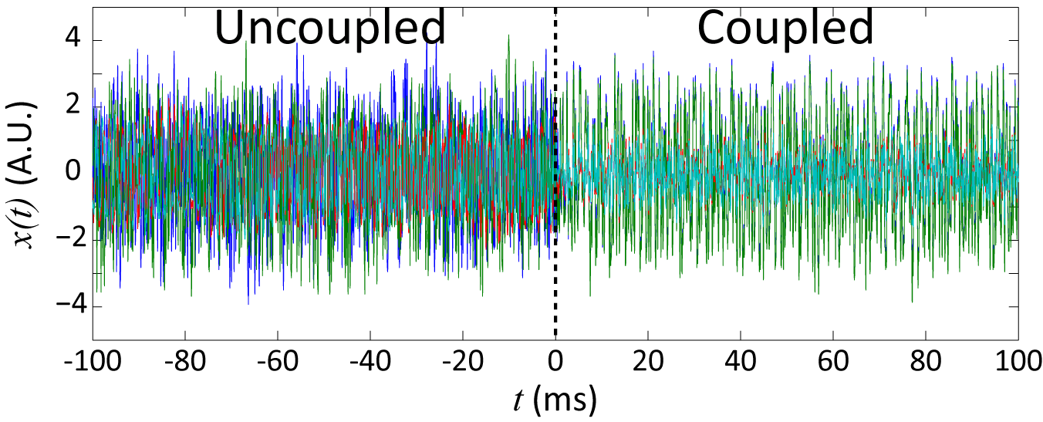
Synchrony of Coupled Groups
Notes:
-complex/chaotic dynamics

Slide 37
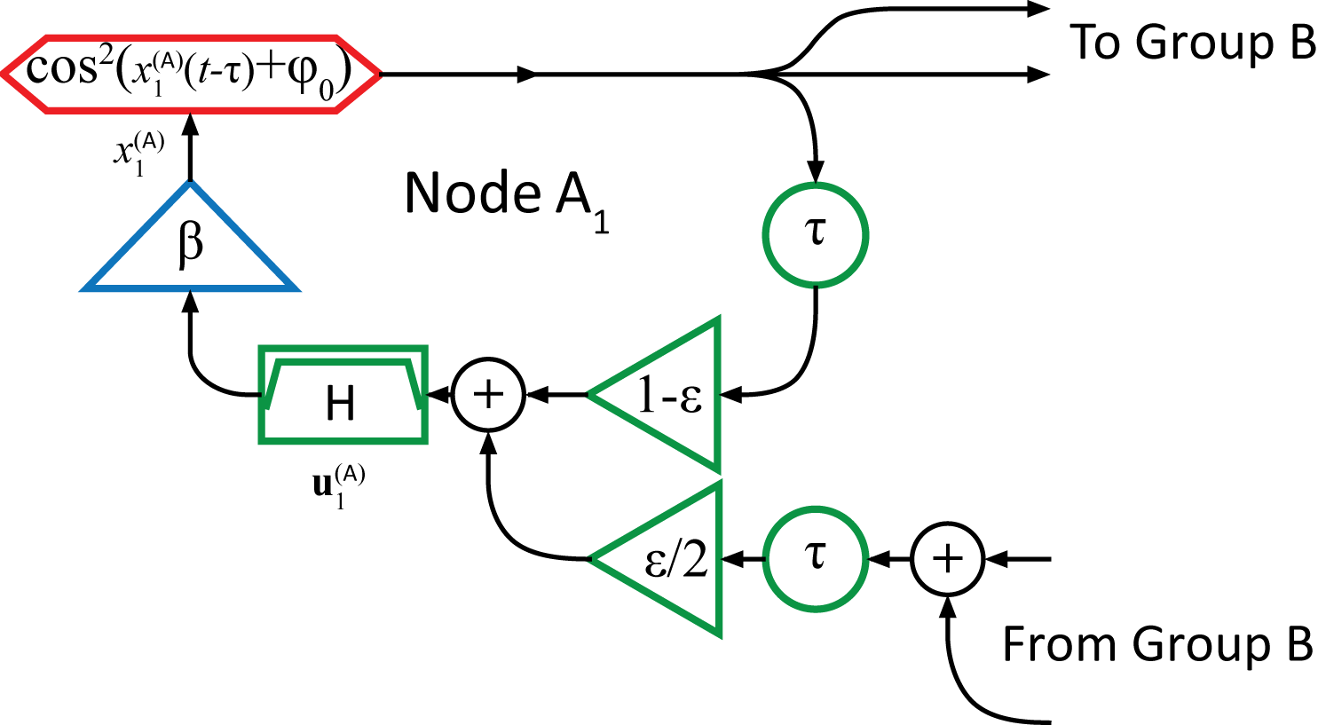
Mathematical Model
Notes:
-Note here that both coupling delay and feedback delay are the same

Slide 38
Mathematical Model
Notes:
-point out beta values
-apples and oranges

Slide 39
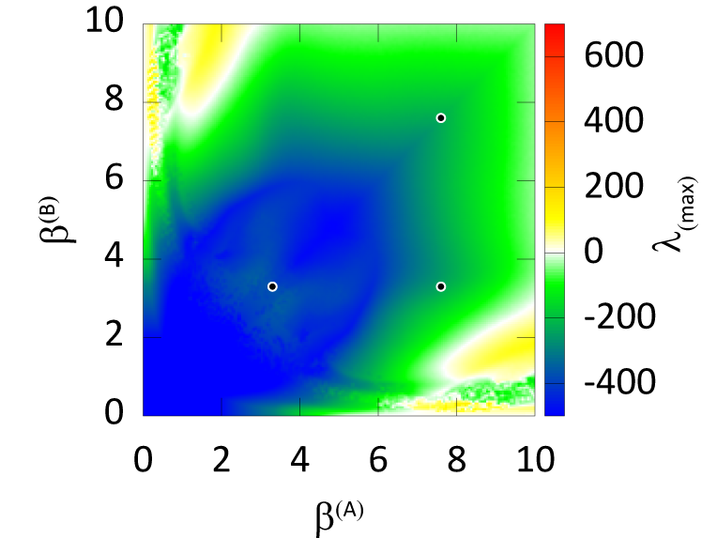
Stability of Group Synchrony
Notes:
-coupling matrix K, with eigenvalues gamma
-calculate MSF (max Lyap exp) for different gammas, plot as a function of two beta parameters (color is MSF, lambda max, max Lyap exp)
-+/- 1 eigenvalue corresponds to longitudinal perturbations in the synchronous manifold, so determines nature of dynamics of coupled system, red/yellow chaotic, white periodic, blue/green fixed point; symmetry considerations result in identical MSF for +/- 1 eigenvalues
0 eigenvalues correspond to perturbations away from the group synchronous manifold, so tell stability of group synch solution – blue/green stable
-three points we will consider – two with identical parameters for two groups, one with very different beta parameter for each group – all three points should give chaotic dynamics and stable group sync
-may want to flip back here on later slides

Slide 40
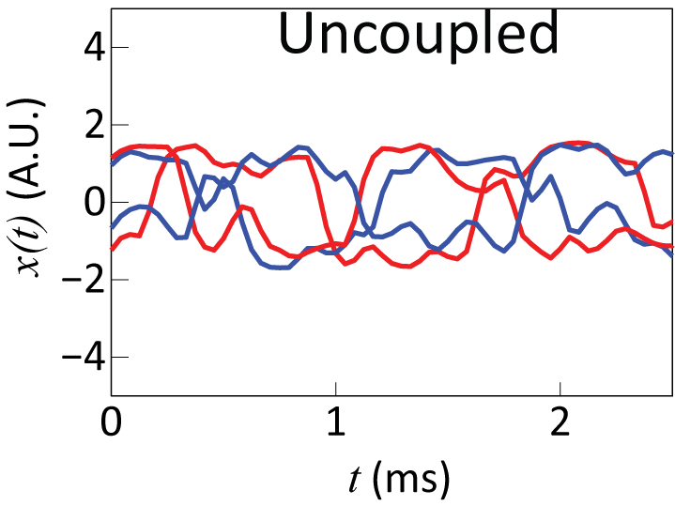
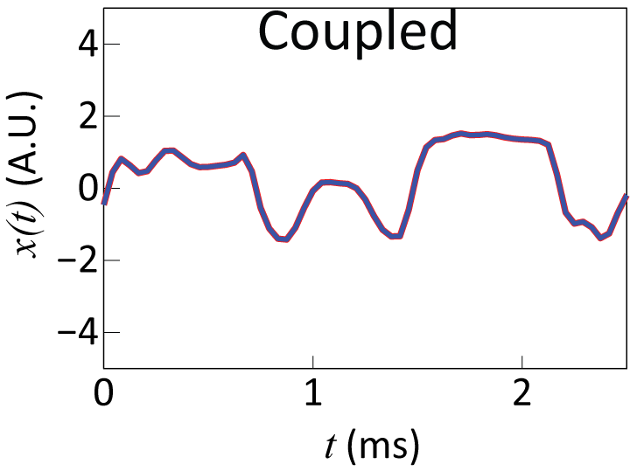
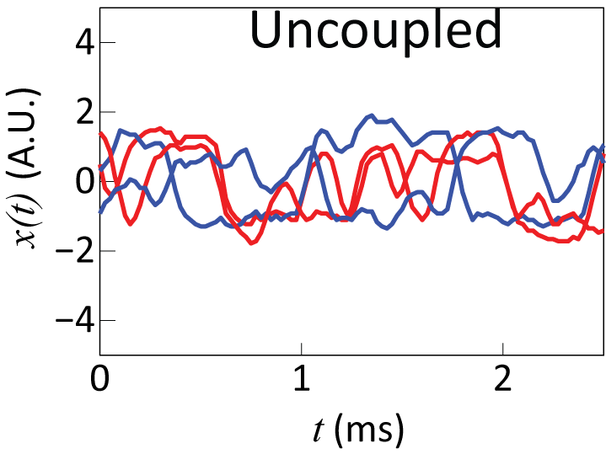
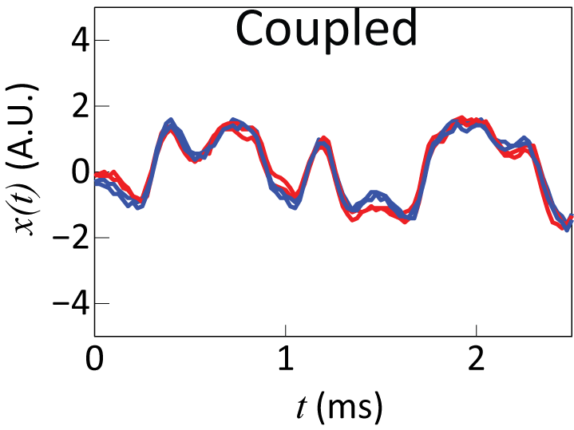
Global Synchrony
β^{(A)}=β^{(B)} = 3.3
Simulation
Experiment

Slide 41
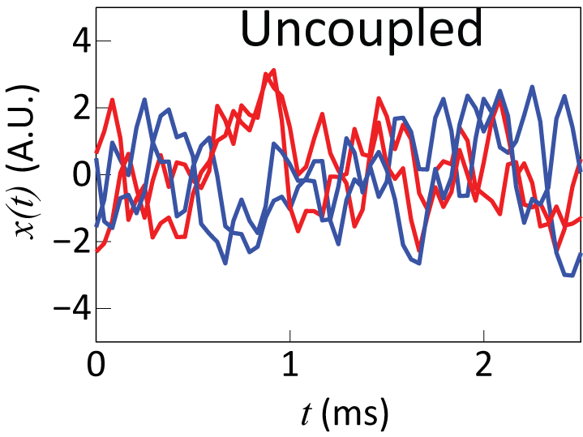
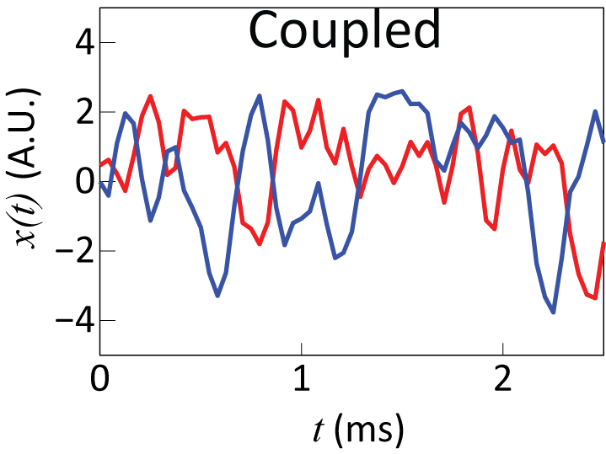
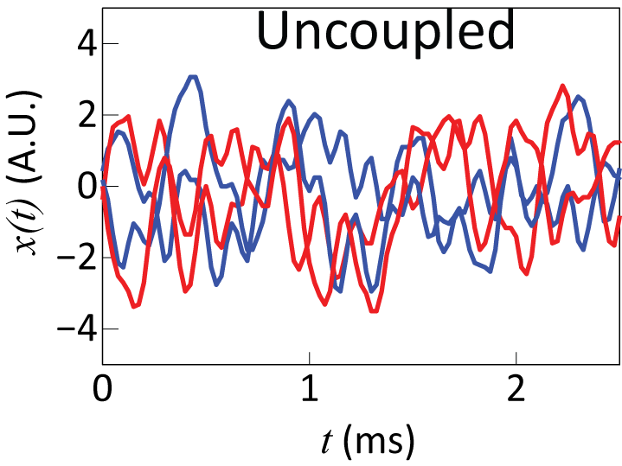
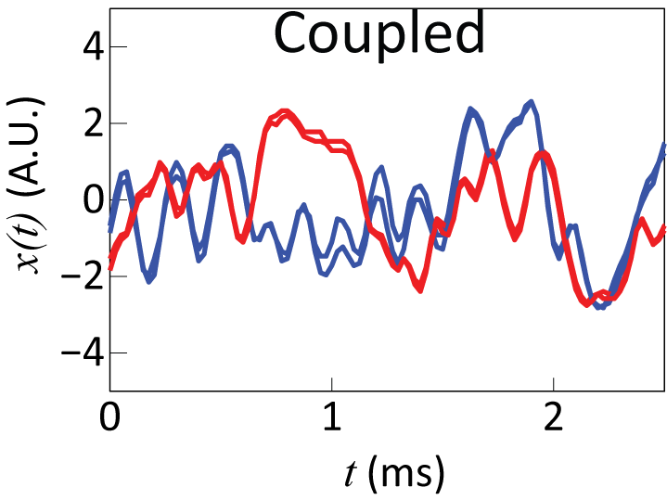
Cluster Synchrony
β^{(A)}=β^{(B)} = 7.6
Simulation
Experiment

Slide 42
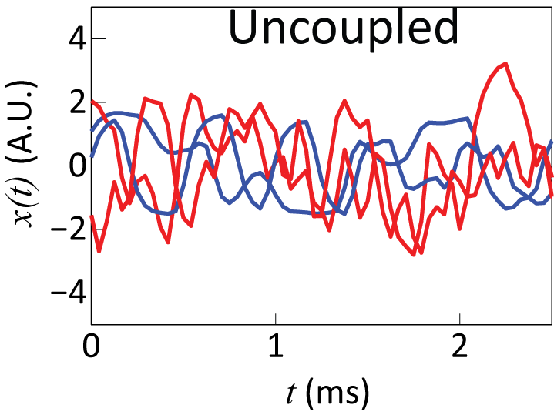
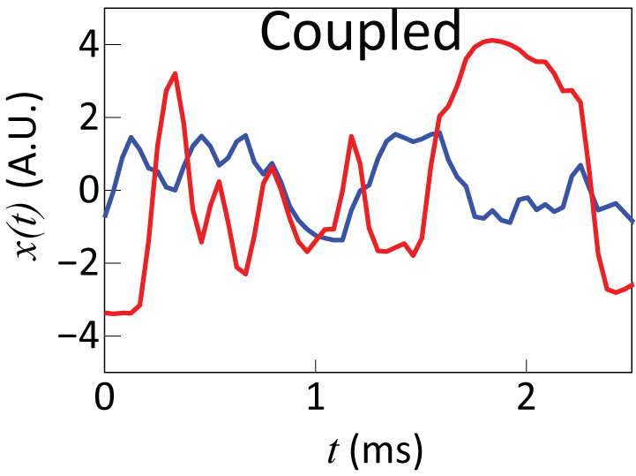
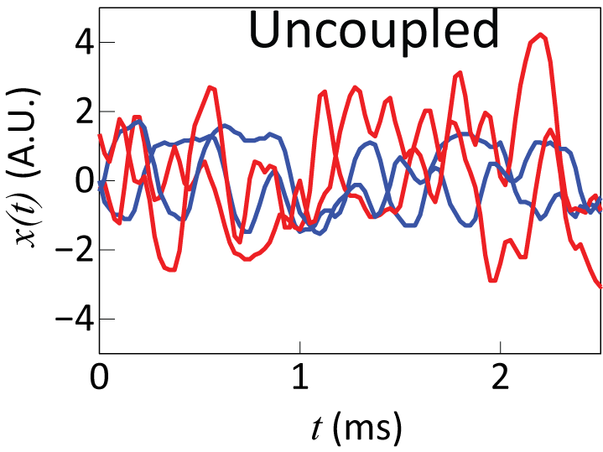
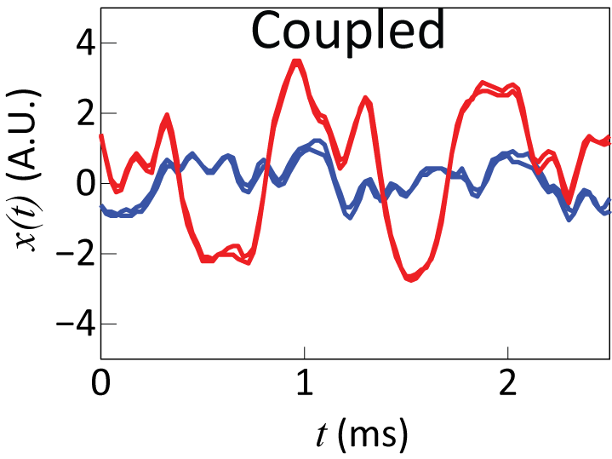
Group Synchrony
β^{(A)}=7.6
β^{(B)} = 3.3
Simulation
Experiment

Slide 43
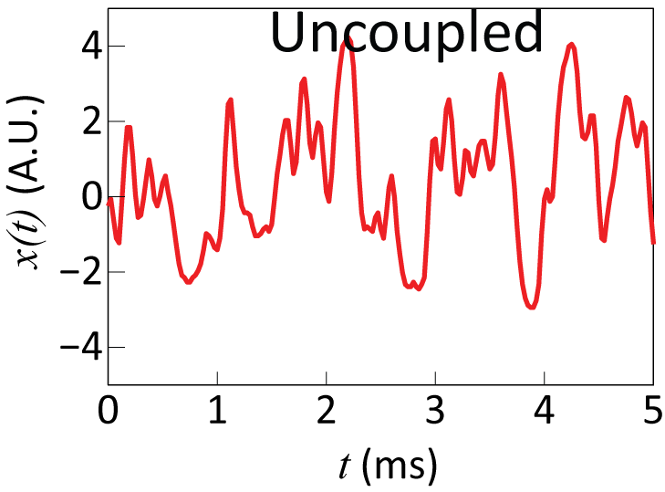
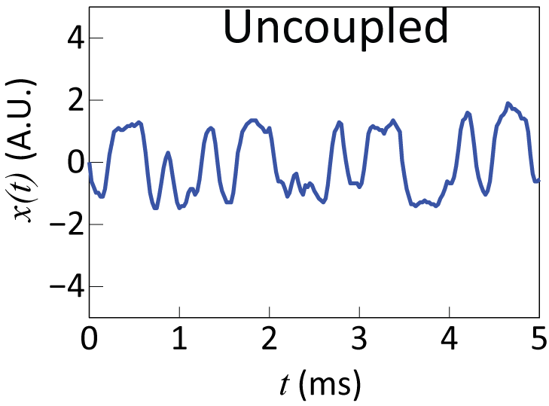
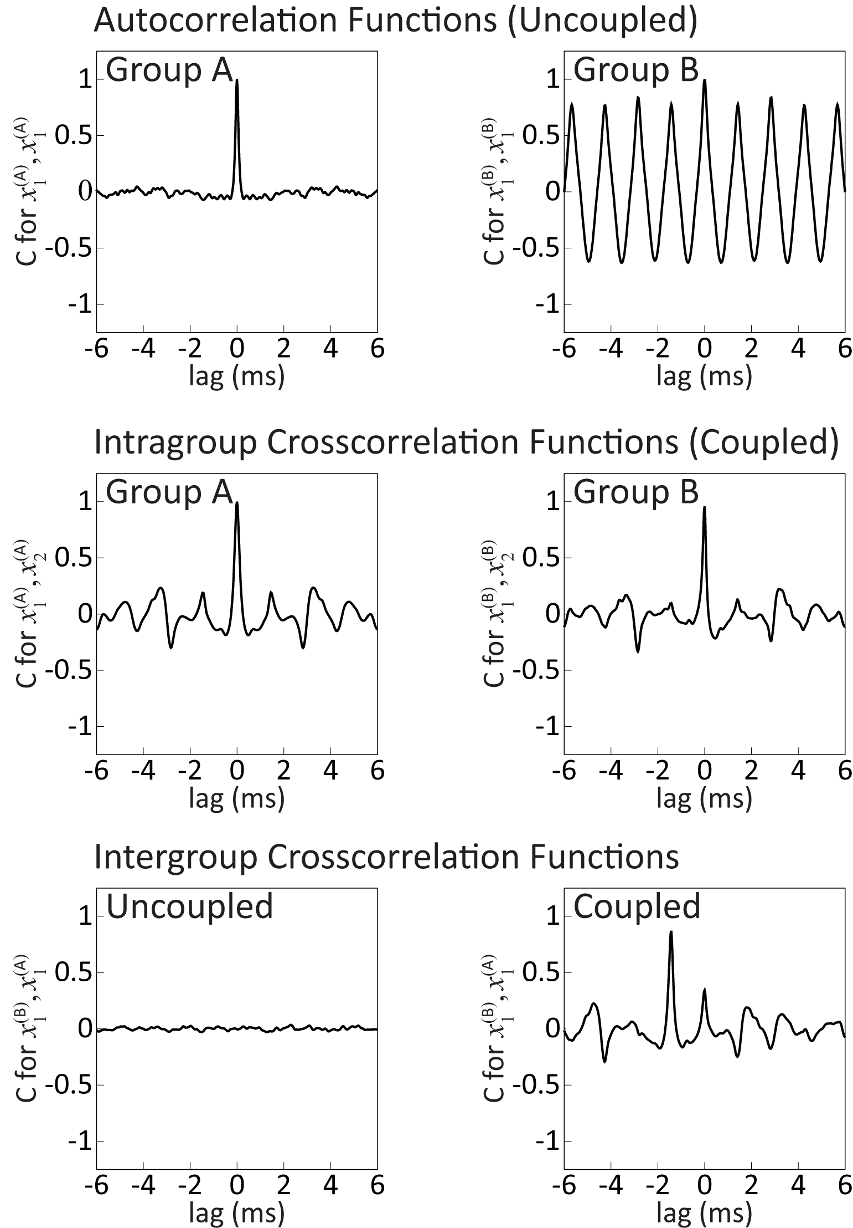
Dissimilar Nodes
β^{(A)} = 7.6
β^{(B)} = 3.3
Autocorrelation Function
Autocorrelation Function

Slide 44
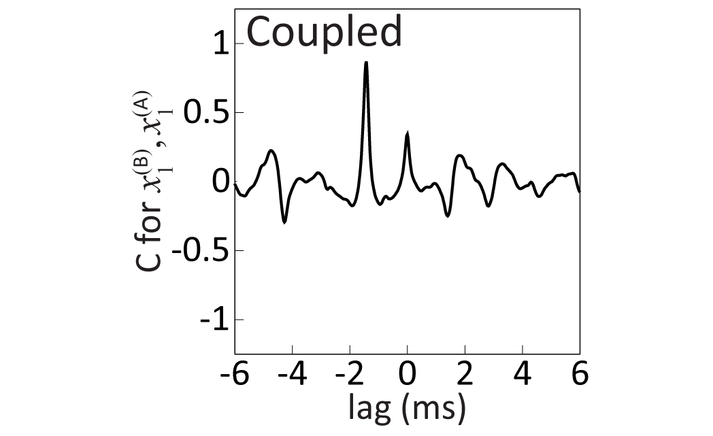
Coupled Nodes
Cross-correlation Function

Slide 45
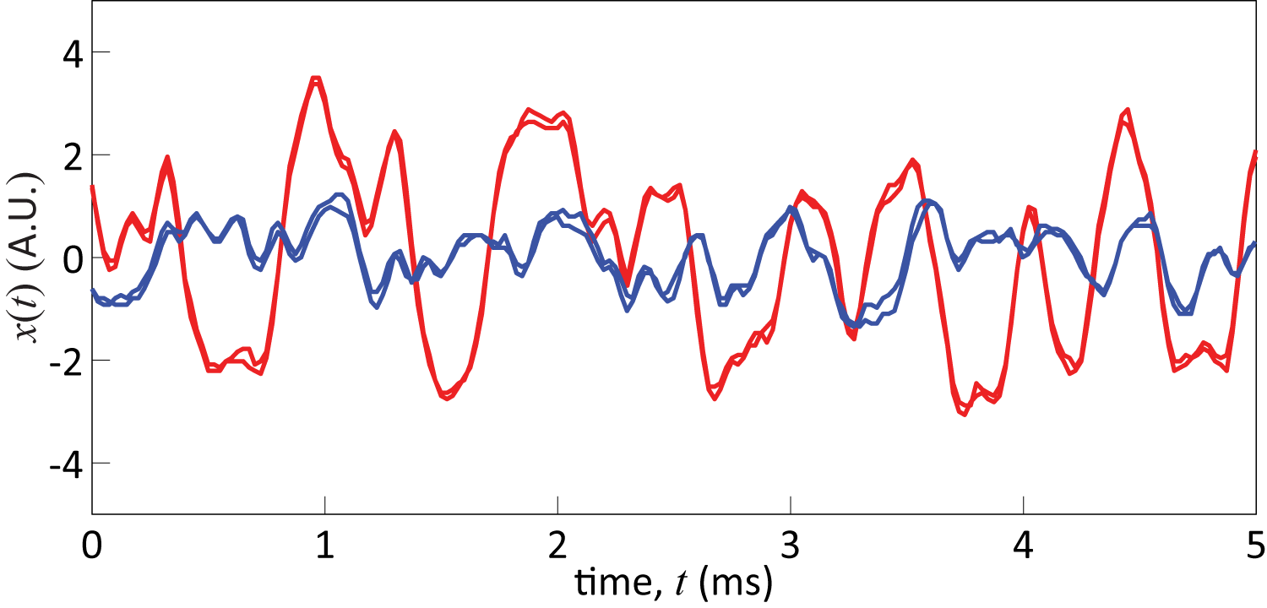
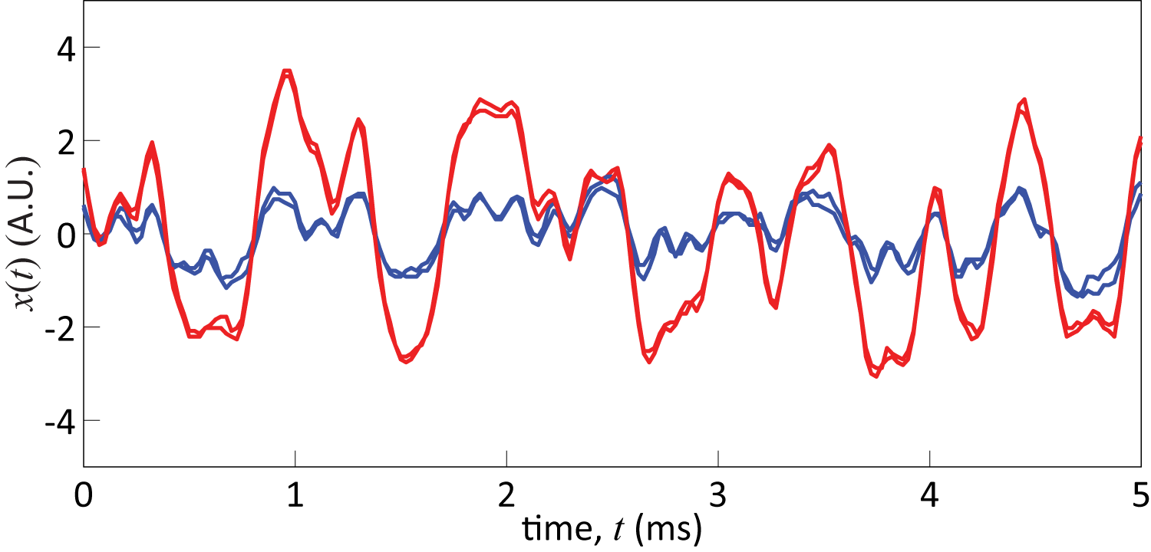
Group Synchrony and Time-lagged Phase Synchrony
Group B Traces Delayed
Notes:
-interesting that even though group B has the smaller amplitude, it is the leader of the lagged synchrony

Slide 46
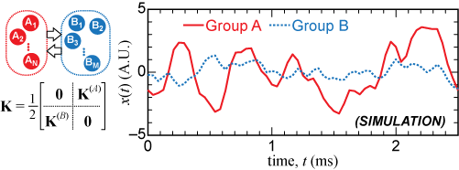
Group Sync for Different Structures
Notes:
-show generality, details are less important – other instances where this happens
Talk about the different structures we tried with group sync
Mention (show?) conditions on coupling matrix
Show pictures of different networks
Include larger network simulations

Slide 47
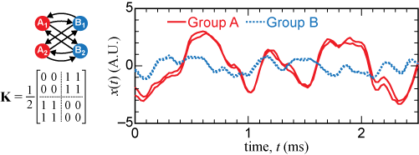
Group Sync for Different Structures
Notes:
-show generality, details are less important – other instances where this happens
Talk about the different structures we tried with group sync
Mention (show?) conditions on coupling matrix
Show pictures of different networks
Include larger network simulations

Slide 48

Group Sync for Different Structures
Notes:
-show generality, details are less important – other instances where this happens
Talk about the different structures we tried with group sync
Mention (show?) conditions on coupling matrix
Show pictures of different networks
Include larger network simulations

Slide 49

Larger Networks

Slide 50
Conclusions I
Shown transitions between isochronal, cluster, and splay-phase synchrony by varying coupling delays between periodic oscillators
Have an experiment with tunable coupling delay
Tested stability calculations and predictions with experiments and simulations

Slide 51
Conclusions II
Experimental demonstration of global, cluster and group synchrony
Stability calculations extended to group synchrony with time-delayed systems, used to correctly predict experimental results of this optoelectronic system, with coupled non-identical nodes
Results can be generalized to groups of different sizes, and to different coupling configurations

Slide 52
Acknowledgements
Thomas E. Murphy, Rajarshi Roy (University of Maryland)
Francesco Sorrentino (Mechanical Engineering, University of New Mexico)
Thomas Dahms, Eckehard Schöll (Tecnische Universität Berlin)
MURI grant ONR N000140710734 (CRSW, TEM, RR)
DFG in the framework of SFB 910 (TD, ES)
Adam Cohen and Bhargava Ravoori
Hien Dao and Aaron Hagerstrom

