Slide 1

Complex dynamics of a microwave time-delayed feedback loop
Chemical Physics Graduate Program
Hien Dao
PhD Thesis Defense
September 4th , 2013
Committee:
Prof. Thomas Murphy - Chair
Prof. Rajarshi Roy
Dr. John Rodgers
Prof. Michelle Girvan
Prof. Brian Hunt – Dean Representative

Slide 2
Outline
Introduction:
    Deterministic chaos
    Deterministic Brownian motion
    Delay differential equations
Microwave time-delayed feedback loop:
    Experimental setup
    Mathematical model
    Complex dynamics:
    - The loop with sinusoidal nonlinearity: bounded and unbounded dynamics regimes
    - The loop with Boolean nonlinearity
Potential applications:
    - Range and velocity sensing
Conclusion
Future works
Notes:
Here is the outline of the talk. In the first part, I will give out the general introduction on deterministic chaos, deterministic B motion and delay differential equations. Through the introductory information, I will draw the motivation of the research subject. I will then move on to talk about …, how we setup the experimental system, how we model the loop and the complex dynamics we could observe in the loop. I also will address significant of the result by demonstrating the potential range and velocity sensing application using FM chaotic signal generated by the loop. I conclude the talk by presenting conclusion and propose future research.

Slide 3
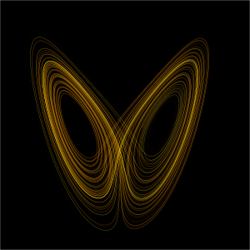

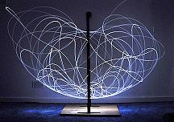
Introduction :
Deterministic chaos
Deterministic Brownian motion
Delay differential equations
Chaos
Quantifying chaos
Type of chaotic signal
Microwave chaos
‘‘An aperiodic long term behavior of a bounded deterministic system that exhibits sensitive dependence on initial conditions’’ – J. C. Sprott, Chaos and Time-series Analysis
Universality
  Wikipedia
  Lorenz attractor
  Wikipedia
The distribution of dye in a fluid http://www.chaos.umd.edu/gallery.html
Motion of double compound pendulum
Applications:
- Communication G. D. VanWiggeren, and R. Roy, Science 20, 1198 (1998)
- Encryption L. Kocarev, IEEE Circ. Syst. Mag 3, 6 (2001)
- Sensing, radar systems J. N. Blakely et al., Proc. SPIE 8021, 80211H (2011)
- Random number generation A. Uchida et al., Nature Photon. 2, 728 (2008)
-…
Notes:
The general definition of chaos states that chaos is aperiodic long term behaviorof a bounded deternministics systsm that exhibit the sen.. The first well known example of chaos is Lorenz system. While working on modeling the weather system, he discovered that a set of three first order, coupled nonlinear equations could display the aperiodic solution. This solution is never setlle down to an equilibrium or periodic state instead it continues to oscillate in aperiodic fashion. If the simukation starts from slightly different I c, the trajectories could be strongly divert. Nowadays, it is clear that one could observe this chaotic behavior in most branches of science. The two example shown here are from fluid dynamics and mechanics. The uniqueness and universality of chaos can bring it to different applications, such as

Slide 4
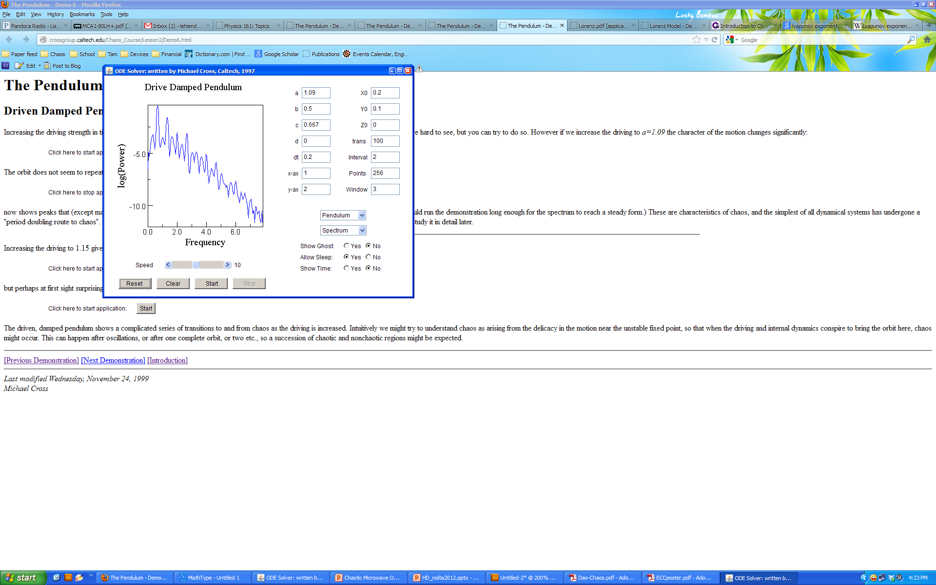
Introduction :
Deterministic chaos
Deterministic Brownian motion
Delay differential equations
Chaos
Quantifying chaos
Type of chaotic signal
Microwave chaos
Lyapunov exponents and
The quantity whose sign indicates chaos and its value measures the rate at which initial nearby trajectories exponentially diverge.
- A positive maximal Lyapunov exponent is a signature of chaos.
Kaplan – Yorke dimensionality
Kaplan-Yorke dimension: fractal dimensionality
Power spectrum
- Broadband behavior
Power spectrum of a damp, driven pendulum’s aperiodic motion

Slide 5
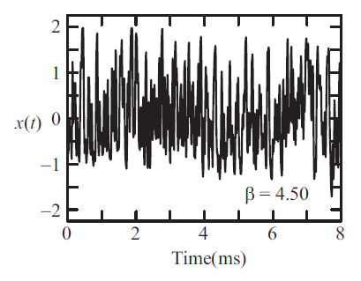
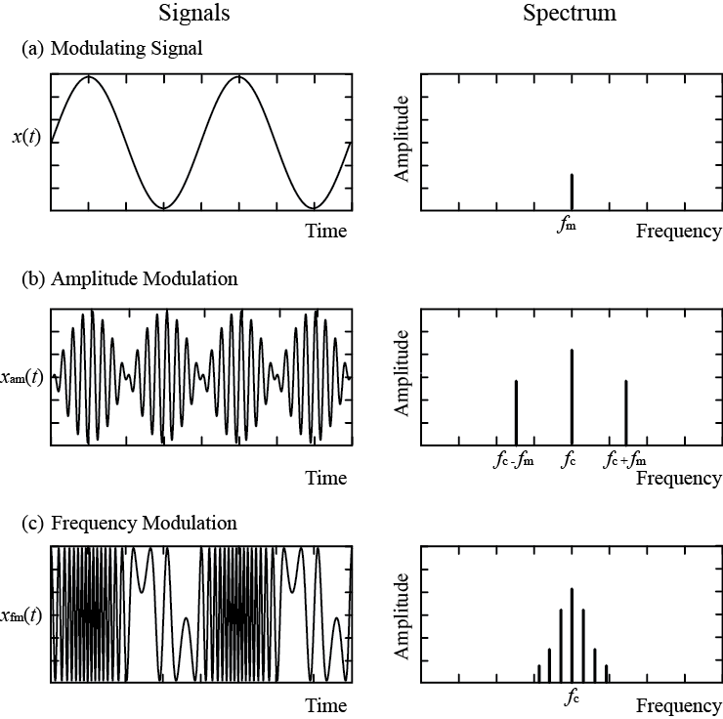
Deterministic chaos
Deterministic Brownian motion
Delay differential equations
Chaos
Quantifying chaos
Type of chaotic signals
Microwave chaos
Introduction :
Chaotic signal
Lorenz system’s chaotic solution
Chaos in amplitude or envelope
A.B. Cohen et al, PRL 101, 154102 (2008)
Chaos in phase or frequency!!
x (t)
Demonstration of a frequency-modulated signal
Time

Slide 6
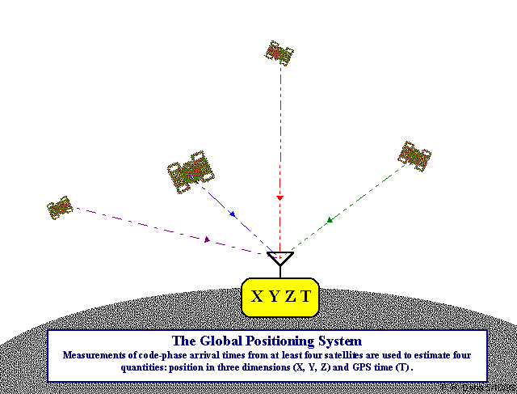
Deterministic chaos
Deterministic Brownian motion
Delay differential equations
Chaos
Quantifying chaos
Type of chaotic signals
Microwave chaos
Introduction :
Modern communication: cell-phones, Wi-Fi, GPS, radar, satellite TV, etc…
Advantages of chaotic microwave signal:
  Wider bandwidth and better ambiguity diagram
  Reduced interference with existing channels
  Less susceptible to noise or jamming
Global Positioning System
http://www.colorado.edu/geography/gcraft/notes/gps/gps_f.html
Frequency modulated chaotic microwave signal.

Slide 7
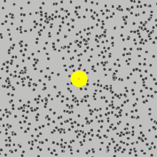
Introduction :
Deterministic chaos
Deterministic Brownian motion
Delay differential equations
Definition
Properties
Hurst exponents
Brownian motion:
A random movement of microscopic particles suspended in liquids or gases resulting from the impact of molecules of the surrounding medium
A macroscopic manifestation of the molecular motion of the liquid
Deterministic Brownian motion:
Simulation of Brownian motion - Wikipedia
A Brownian motion produced from a deterministic process without the addition of noise

Slide 8
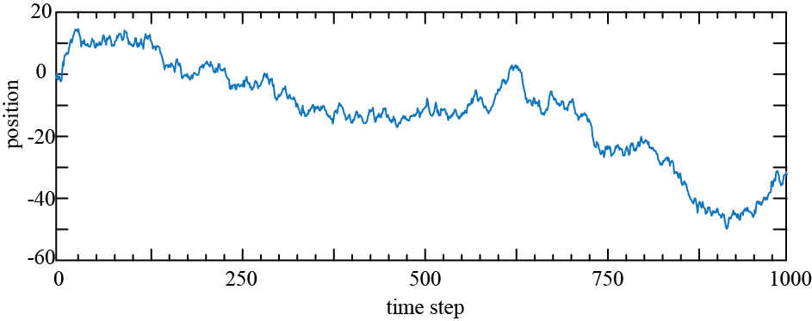
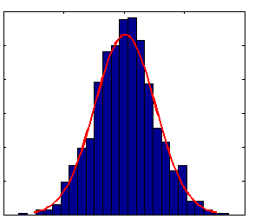
Introduction :
Deterministic chaos
Deterministic Brownian motion
Delay differential equations
Definition
Properties
Hurst exponents
120
Gaussian distribution of the displacement over a given time interval.
80
Probability distribution
40
0
-4
0
4
Bins width

Slide 9
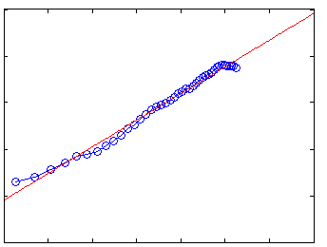
Introduction :
Deterministic chaos
Deterministic Brownian motion
Delay differential equations
Definition
Properties
Hurst exponents
H: Hurst exponent
0 < H < 1
Fractional Brownian motions:
1.2
H = 0.5 regular Brownian motion
H < 0.5 anti-persistence Brownian motion
H > 0.5 persistence Brownian motion
0.8
H = 0.57
0.4
1.6
2
2.4
2.8

Slide 10
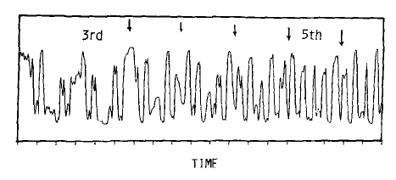
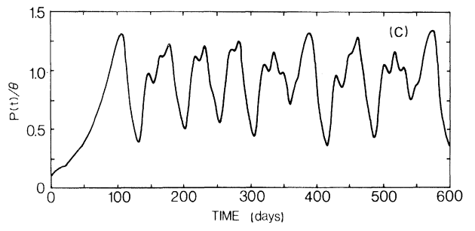
Introduction :
Deterministic chaos
Deterministic Brownian motion
Delay differential equations
History
System realization
Ikeda system
Mackey-Glass system
Optoelectronic system
K. Ikeda and K. Matsumoto, Physica D 29, 223 (1987)
M. C. Mackey and L. Glass, Science 197, 287 (1977)
A.B. Cohen et al, PRL 101, 154102 (2008)
Y. C. Kouomou et al, PRL 95, 203903 (2005)
Chaos is created by nonlinearly mixing one physical variable with its own history.

Slide 11
Introduction :
Deterministic chaos
Deterministic Brownian motion
Delay differential equations
History
System realization
“…To calculate x(t) for times greater than t, a function x(t) over the interval (t, t - τ) must be given. Thus, equations of this type are infinite dimensional…”
J. Farmer et al, Physica D 4, 366 (1982)
Time-delayed feedback loop
Nonlinearity
Nonlinearity
Delay
Filter function
x(t)
Gain
Filter
Delay

Slide 12
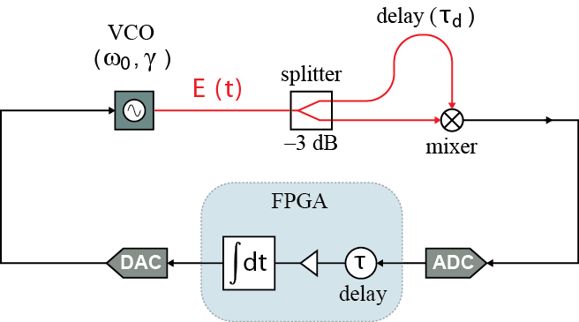
Microwave time-delayed feedback loop:
Experimental setup
Mathematical model
Complex dynamics

Slide 13

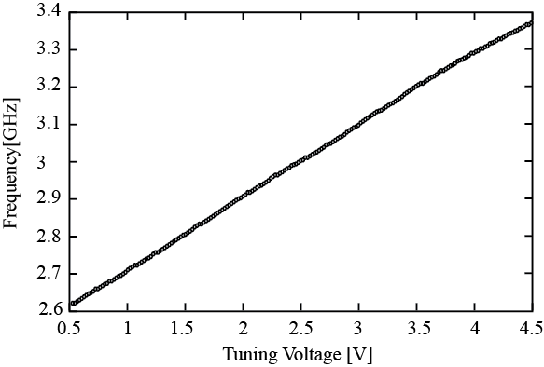
Microwave time-delayed feedback loop:
Experimental setup
Mathematical model
Complex dynamics
Voltage Controlled Oscillator
Baseband signal
FM Microwave signal
Mini-circuit VCO
SOS-3065-119+

Slide 14
Microwave time-delayed feedback loop:
Experimental setup
Mathematical model
Complex dynamics
A homodyne microwave phase discriminator
varies slowly on the time scale

Slide 15
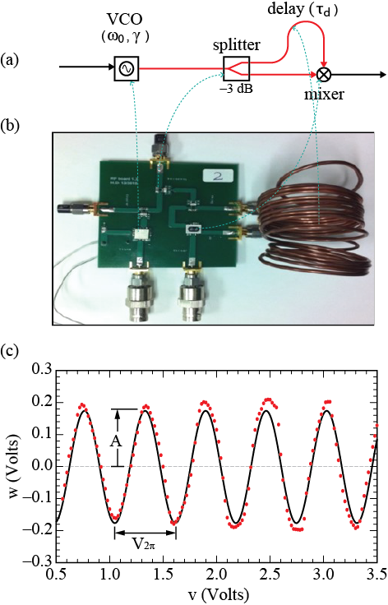
Microwave time-delayed feedback loop:
Experimental setup
Mathematical model
Complex dynamics
A printed- circuit board microwave generator
Nonlinear function

Slide 16
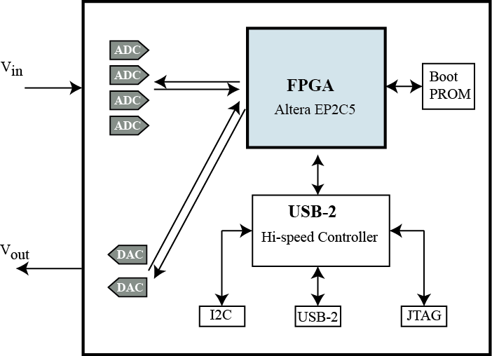
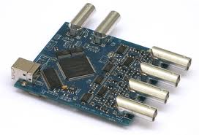
Microwave time-delayed feedback loop:
Experimental setup
Mathematical model
Complex dynamics
Field Programmable Gate Array board
Output
FX2 USB port
DAC
FPGA chip
ADC
Input
Altera Cyclone II
Sampling rate: F_{s} = 75.75 Msample/s
2 phase-locked loop built in
8-bit ADC
10-bit DAC

Slide 17
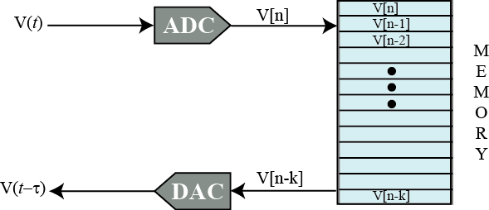
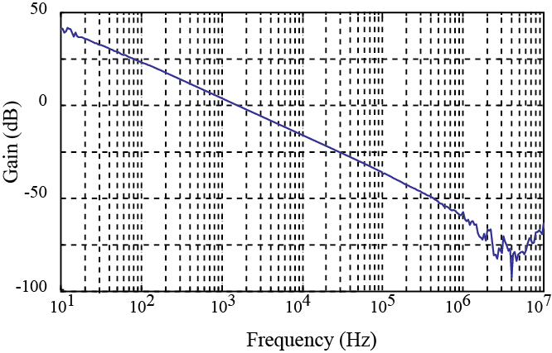
Microwave time-delayed feedback loop:
Experimental setup
Mathematical model
Complex dynamics
Memory buffer with length N to create delay τ
Discrete map equation for filter function
H(s)
H(z)
Discrete map equation
T: the integration time constant

Slide 18
Microwave time-delayed feedback loop:
Experimental setup
Mathematical model
Complex dynamics
The ‘simplest’ time-delayed differential equation
M. Schanz et al., PRE 67, 056205 (2003)
J. C. Sprott, PLA 366, 397 (2007)

Slide 19
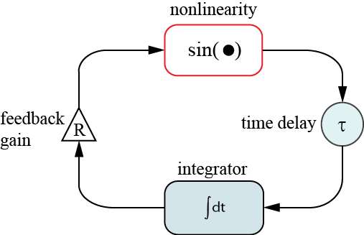
Microwave time-delayed feedback loop:
Experimental setup
Mathematical model
Complex dynamics
Experimental setup
Mathematical model

Slide 20
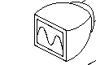
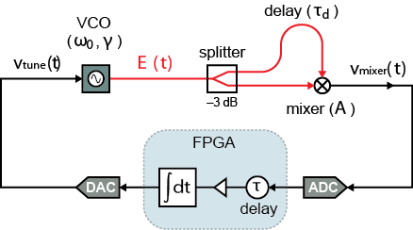
Microwave time-delayed feedback loop:
Experimental setup
Mathematical model
Complex dynamics
Experiment
Simulation
scope
Parameter | Value
sampling rate | 15 MS/s
N | 600
A | 0.2V
v_{2π} | 0.5V
γ | 180 MHz/V
ω₀/2π | 2.92 GHz
α (40-bit) | 0.0067-0.0175
5th order Dormand-Prince method
Random initial conditions
Pre-iterated to eliminate transient
τ= 40 μs
R is range from 1.5 to 4.2

Slide 21
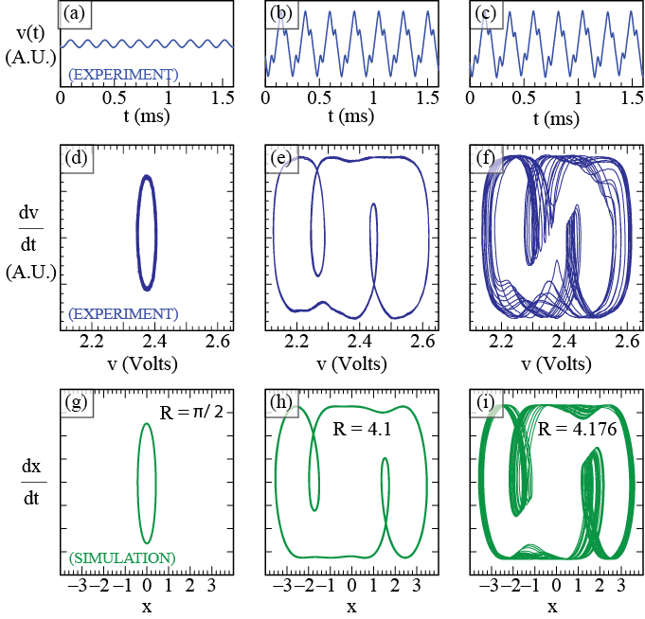
Microwave time-delayed feedback loop:
Experimental setup
Mathematical model
Complex dynamics
R = π/2
Low feedback strength generated periodic behavior.
Period: 4τ (6.25kHz)

Slide 22
Microwave time-delayed feedback loop:
Experimental setup
Mathematical model
Complex dynamics
R = 4.1
Intermediate feedback strength generated: More complicated but still periodic behavior.

Slide 23
Microwave time-delayed feedback loop:
Experimental setup
Mathematical model
Complex dynamics
R = 4.176
High feedback strength: Chaotic behavior.
Irregular, aperiodic but still deterministic.
λ_{max} = +5.316/t , D_{K-Y} = 2.15

Slide 24
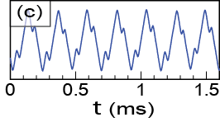
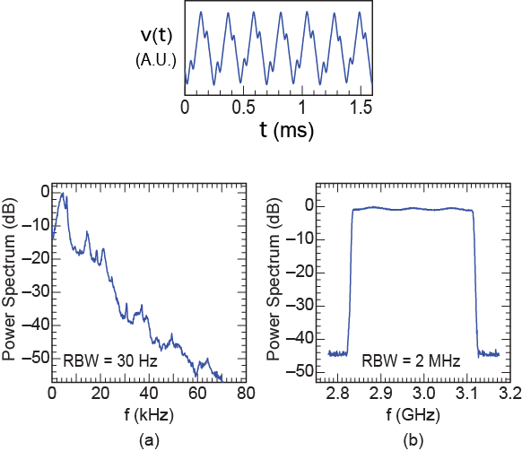
Microwave time-delayed feedback loop:
Experimental setup
Mathematical model
Complex dynamics
Power spectra
microwave
baseband

Slide 25
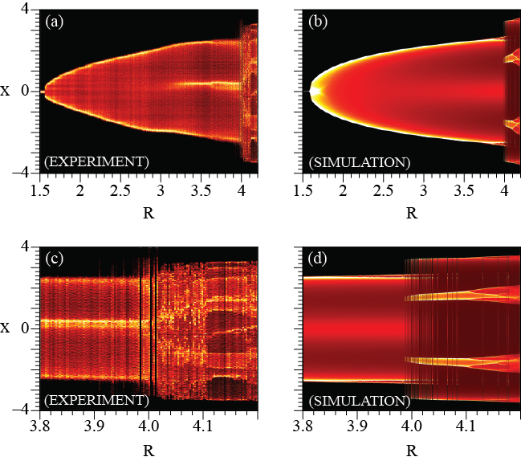
Microwave time-delayed feedback loop:
Experimental setup
Mathematical model
Complex dynamics
Bifurcation diagrams
Period-doubling route to chaos
Notes:
Remind what the axes are?

Slide 26
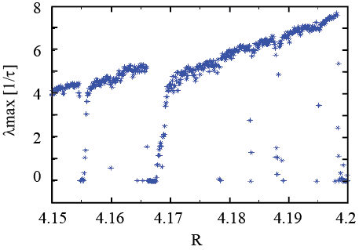
Microwave time-delayed feedback loop:
Experimental setup
Mathematical model
Complex dynamics
Maximum Lyapunov exponents
Positive λ_{max} indicates chaos.

Slide 27
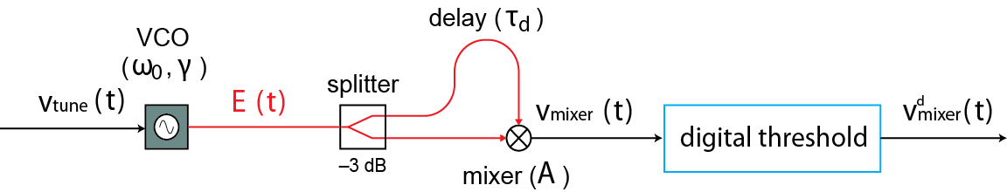
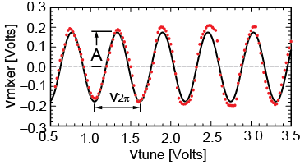
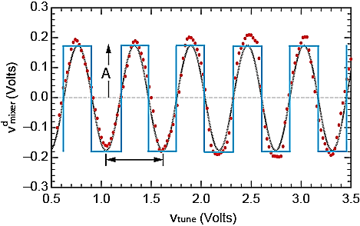
Microwave time-delayed feedback loop:
Experimental setup
Mathematical model
Complex dynamics
Another nonlinearity

Slide 28
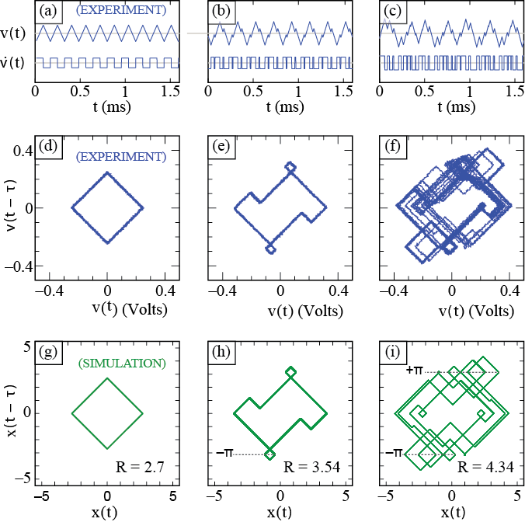
Microwave time-delayed feedback loop:
Experimental setup
Mathematical model
Complex dynamics
Time traces and time-embedding plot
No fixed point solution
Always periodic
Amplitudes are linearly dependence on system gain R
R >3π/2, the random walk behavior occurs (not shown)
Notes:
Amplitude continues to grow in proportion to R but the trajectory acquire secondary peaks on the rising and falling

Slide 29
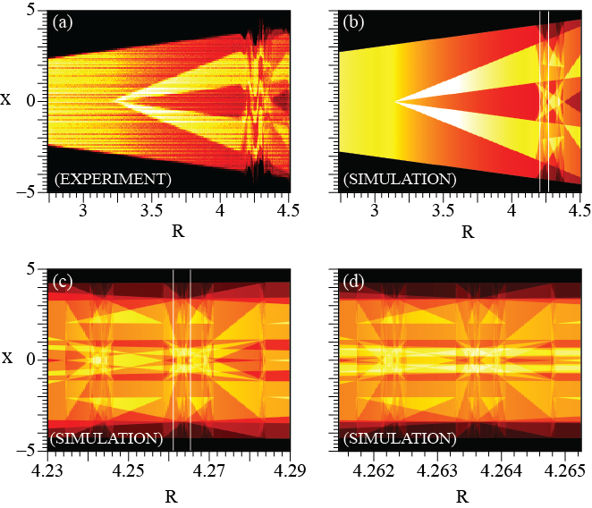
Microwave time-delayed feedback loop:
Experimental setup
Mathematical model
Complex dynamics
Bifurcation diagrams
(c) is a zoomed in version of the rectangle in (b)
(d) Is a zoomed in version of the rectangle in (c).
Periodic, but self-similar!

Slide 30

Microwave time-delayed feedback loop:
Experimental setup
Mathematical model
Complex dynamics
Unbounded dynamics regime
Yttrium iron garnet (YIG) oscillator
Delay τ_{d} is created using K-band hollow rectangular wave guide
The system reset whenever the signal is saturated
R > 4.9

Slide 31
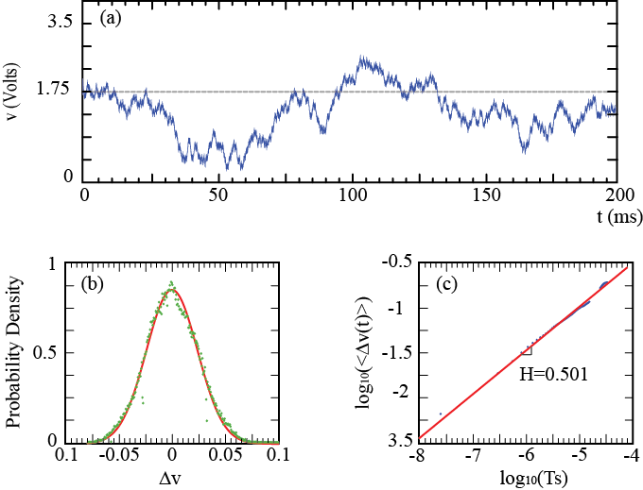
Microwave time-delayed feedback loop:
Experimental setup
Mathematical model
Complex dynamics
Experimental observed deterministic random motion
Tuning voltage time series
Distribution function of displacement
Hurst exponent estimation
The tuning signal exhibits Brownian motion!

Slide 32
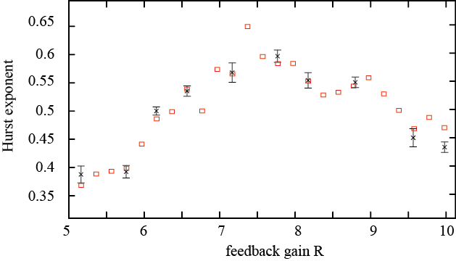
Microwave time-delayed feedback loop:
Experimental setup
Mathematical model
Complex dynamics
Numerically computed
Experimental estimated
I
*
The tuning signal could exhibit fractional Brownian motion.
The system shows the transition from anti-persistence to regular to persistence Brownian motion as the feedback gain R is varied

Slide 33
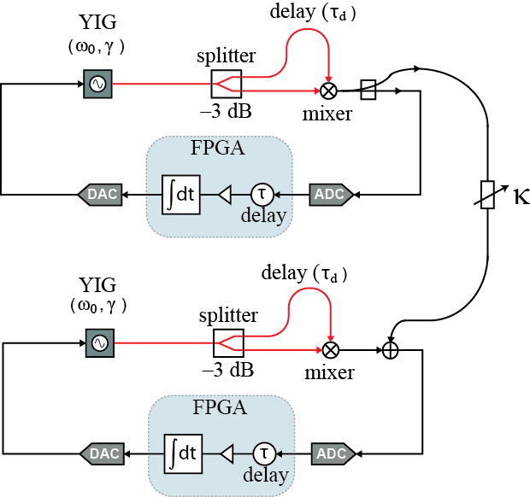
Microwave time-delayed feedback loop:
Experimental setup
Mathematical model
Complex dynamics
Synchronization of deterministic Brownian motions
Unidirectional coupling in the baseband
System equations
Master
The systems are allowed to come to the statistically steady states before the coupling is turned on
Slave

Slide 34
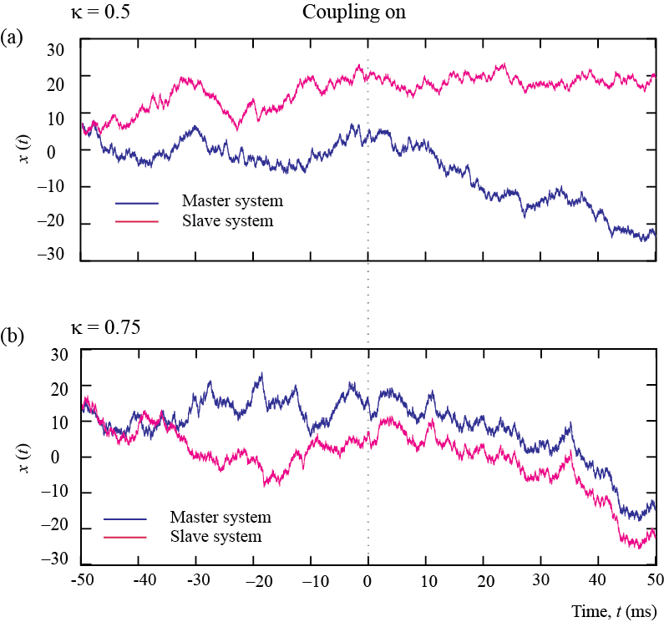
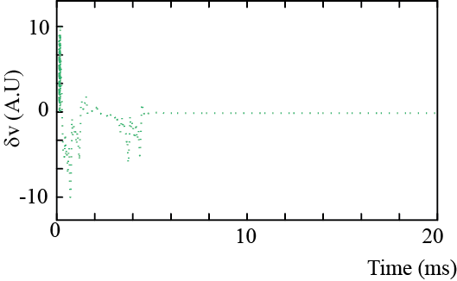
Microwave time-delayed feedback loop:
Experimental setup
Mathematical model
Complex dynamics
Simulation results
Evolution of synchronization perturbation vector
The master system could drives the slave system to behave similarly at different cycle of nonlinearity.
The synchronization is stable.

Slide 35
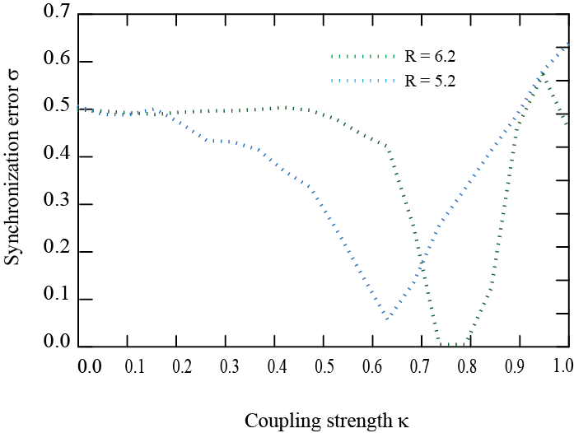
Microwave time-delayed feedback loop:
Experimental setup
Mathematical model
Complex dynamics
Simulation results
Synchronization error σ
Where:
The synchronization ranges depends on the feedback strength R.

Slide 36
Potential Applications
Range and velocity sensor
Random number generator
GPS: using PLL to track FM microwave chaotic signal

Slide 37
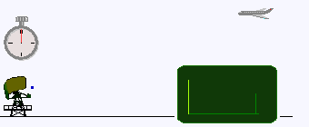
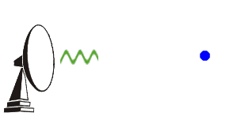
Potential Applications:
Range and velocity sensing application
Ambiguity function
Experimental FM chaotic signal
Objective: Unambiguously determine position and velocity of a target.
ρS(t-τ)
S(t)
S(t)
Pulse radar system - Wikipedia
Doppler radar- Wikipedia
Can we use the FM chaotic signal for S(t)?

Slide 38
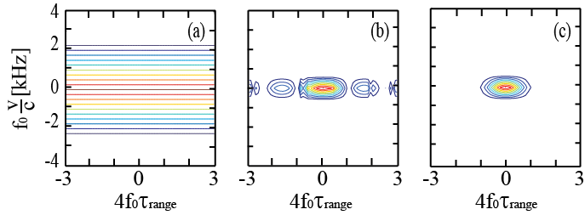
Potential Applications:
Range and velocity sensing application
Ambiguity function
Experimental FM chaotic signal
Formula:
Ideal Ambiguity Function
Ambiguity function for FM signals
- Approximation and normalization
Fixed Point
Periodic
Chaotic

Slide 39
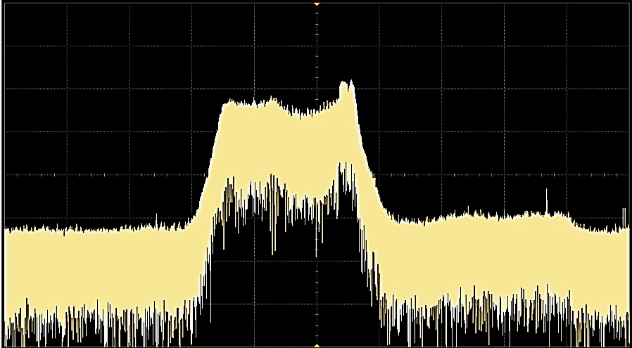
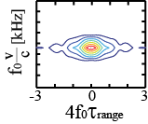
Potential Applications:
Range and velocity sensing application
Ambiguity function
Experimental FM chaotic signal
Spectrum of FM microwave chaotic signal
Broadband behavior at microwave frequency
52 MHz
15dB/div
2.9 GHZ
Experiment
Simulation
Chaotic FM signals shows significant improvement in range and velocity sensing applications.
-3
0
3

Slide 40
Conclusion (1)
Designed and implemented a nonlinear microwave oscillator as a hybrid discrete/continuous time system
Developed a model for simulation of experiment
Investigated the dynamics of the system with a voltage integrator as a filter function
    A bounded dynamics regime:
        Sinusoidal nonlinearity: chaos is possible
        Boolean nonlinearity: self-similarity periodic behavior
    An unbounded dynamics regime: deterministic Brownian motion

Slide 41
Conclusion (2)
Generated FM chaotic signal in frequency range : 2.7-3.5 GHz
Demonstrated the advantage of the frequency-modulated microwave chaotic signal in range finding applications

Slide 42
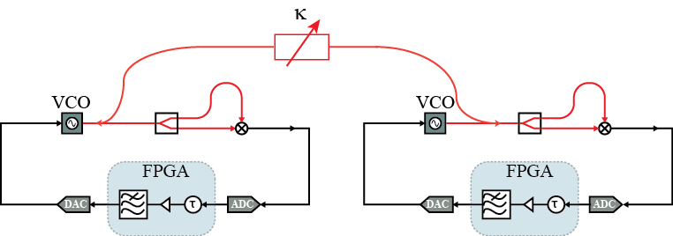
Future work
Frequency locking (phase synchronization) in FM chaotic signals
Network of periodic oscillators
The feedback loop with multiple time delay functions

Slide 43

Thank you!

Slide 44
Supplementary materials

Slide 45
Calculate ambiguity function of Chaos FM signal
Ambiguity function: the 2-dimensonal function of time delay τ and Doppler frequency f showing the distortion of the returned signal;
The value of ambiguity function is given by magnitude of the following integral
Where s(t) is complex signal, τ is time delay and f is Doppler frequency
Chaos FM signal:
Approximation:
where
(operating point)

Slide 46
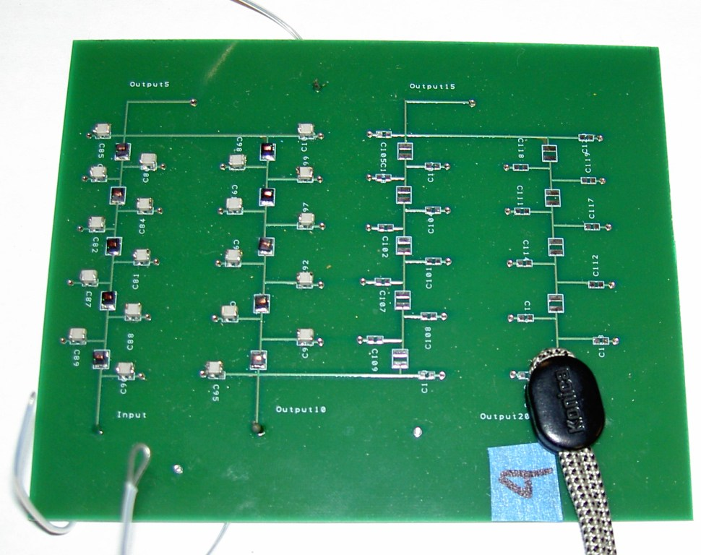
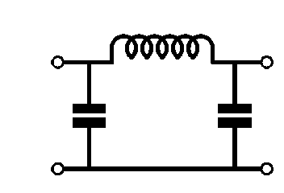
Loop feedback delay t is built in with transmission line design
L/N
L/N
L/N
C/2N
C/2N
C/2N
C/2N
C/2N
C/2N
N units
L=5 μH
C=1nF
τu=0.1 μs/unit;
= 1.2 μs
fcutoff ~ 3 MHz
Notes:
Move to the back, appendix slides for questions.

Slide 47
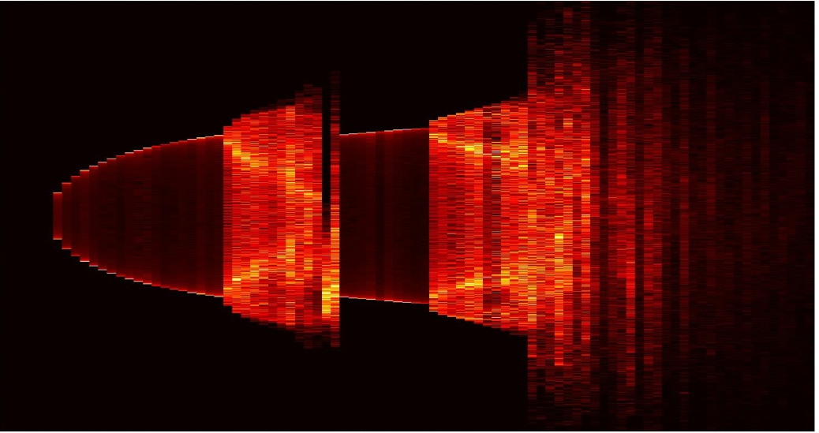
Simulation Results
2
Bifurcation Diagram
X
0
-2
1
2
3
4
5
6
7
β
0.4
β = 1.6
β = 2.7
β = 6.2
0.6
2
X(t)
0
0
0
-0.4
-0.6
0
10
20
0
10
20
-1.5
10
20
Time [μs]
Time [μs]
Time [μs]

Slide 48
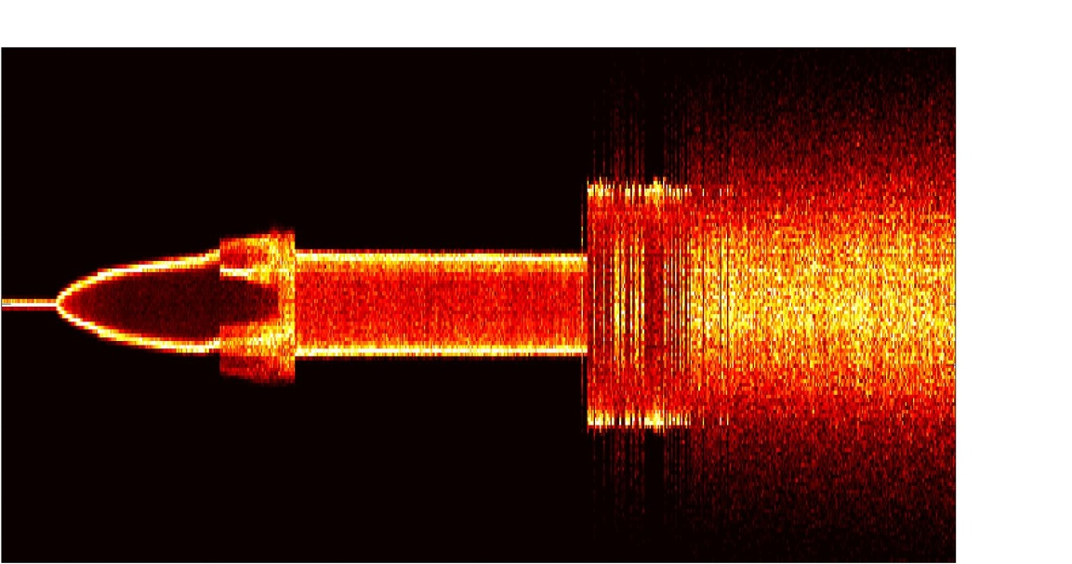
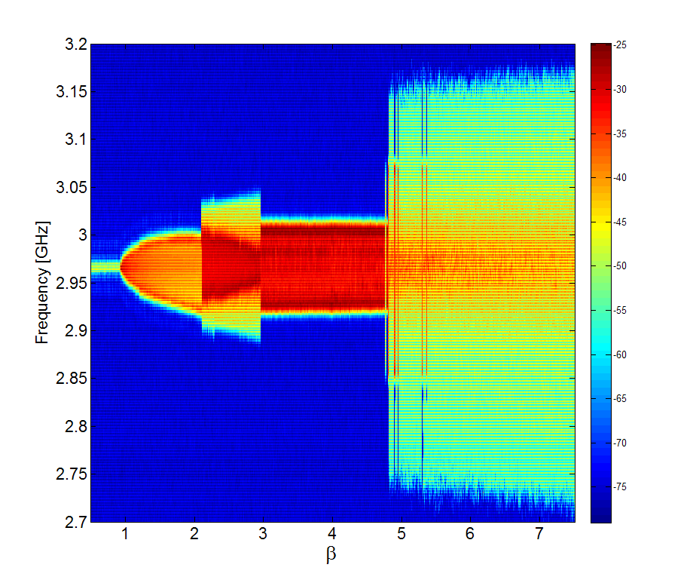
Bifurcation Diagram
2
0
Experiment
V
-2
3.2
3.1
3
Frequency [GHz]
Spectral diagram
of microwave signal
2.9
2.8
2.7
Notes:
Explain what is bifurcation diagram is? Spectral diagram? What kind of dynamical behaviors we can observe? What does it tell us about system?

Slide 49
Coupling and Synchronization
κ
κ : coupling strength
τd
τd
VCO
VCO
v1(t)
splitter
mixer
v2(t)
splitter
mixer
bias
bias
H(s)
β
τ
H(s)
β
τ
(I)
(II)
Two systems are coupled in microwave band within or outside of filter bandwidth
Two possible types of synchronization:
- Baseband Envelope Synchronization
- Microwave Phase Synchronization
Notes:
Why we need to get phase synchronization? What are advantages of that in communication/ control theory? Coupling equation and pointing out what parameter will be compared; what are flexible parameters, i.c to put systems into different regimes; giving some examples about ES and PS done w different systems ;

Slide 50
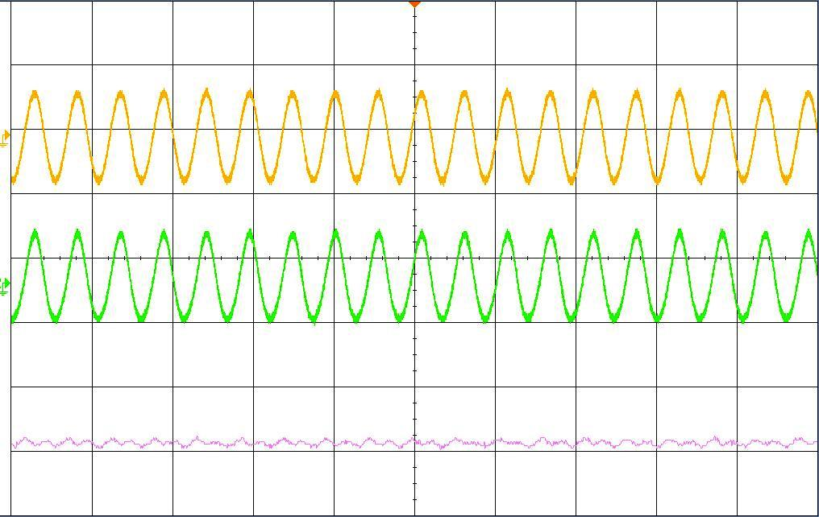



Experimental Results
Unidirectional coupling, outside filter bandwidth, κ = 0.25
β = 1.2
β = 5.1
V₁(t)
V₁(t)
V₂(t)
V₂(t)
V₁(t)-V₂(t)
V₁(t)-V₂(t)
1
5
0
0
-1
-5
0
5
10
15
20
0
5
10
15
20
Time [μs]
Time [μs]

Slide 51




Experimental Results
Bidirectional coupling, outside filter bandwidth, κ = 0.35
β = 1.2
β = 2.1
V₁(t)
V₁(t)
V₂(t)
V₂(t)
V₁(t)-V₂(t)
V₁(t)-V₂(t)
1
2
0
0
-1
-2
0
5
10
15
20
0
5
10
15
20
Time [μs]
Time [μs]

Slide 52
Transmission line for VCO system?
* Microstrip line with characteristic impedance 50 Ohm
Dielectric material: Roger 4350B with
* Using transmission line to provide certain delay time in RF range

Slide 53

Using HFSS to calculate the width of transmission line and simulate the field on transmission line
Width of trace: 0.044’’ thickness of RO3450 : 0.02”; simulation done with f=5GHz

Slide 54

Printed Circuit Board of VCO system

Slide 55

Distance Radar
Transmission line
scope
Idea:
VCO
Using microwave signal generated by VCO for detecting position of object in a cavity
integrator
τ
Mathematical model:
Nonlinearity
In general
RF delay and nonlinearity
V_{2π}
V₀
In particular case has been investigated

Slide 56



Gain =2.5
Gain =4.137
Gain =3.77
How much chances we can detect?

Slide 57
Continuously change τ_{d}
scope
Assumption:
VCO
is in order of 10⁻⁹
integrator
τ
Approximated equation:
Normalization:
Watching dynamics of system, can we determine ω (and then ζ?)

Slide 58
Using PLL to track chaotic FM signal
Chaos Generator
Chaotic FM signal
scope
VCO
v^{p}_{m}
v_{p}
integrator
Mixer output
Or another filter function?
Always can pick
[A²]: voltage as V_{p-p}
Integrator equation
PLL equation

Slide 59
Chaos generator
Equations:
Does solution exist?
In general case, β_{c} and β_{p} could be assumed to be different by some scaling factor β_{c}/β_{p} = n
Static = time evolution ?!

